Slide 1
Tile Matrix Set (TMS) AI-Driven Analysis

Slide 2
Tiling system
References:
Microsoft Bing Tiling System
Open Geospatial Consortium

Slide 3
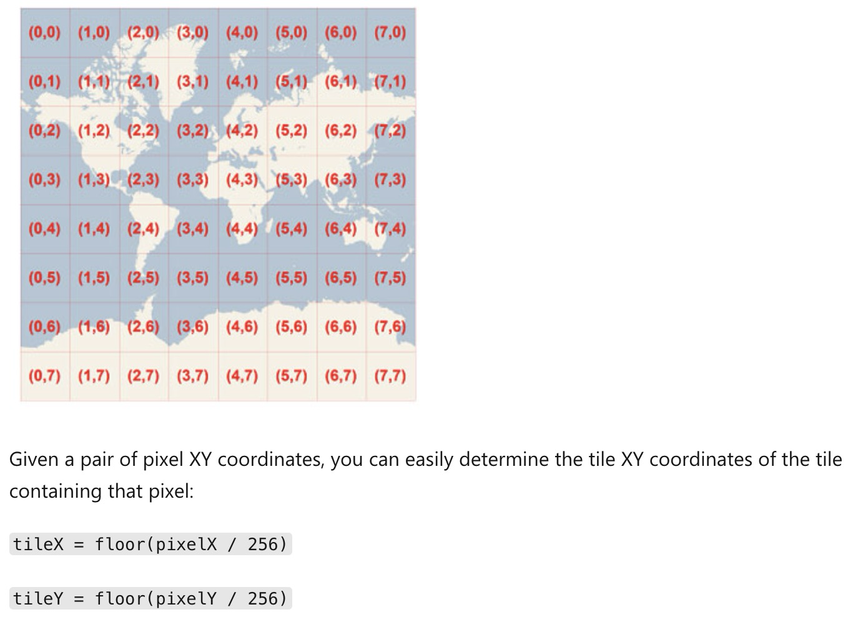
Tile width
Tile Span (Tile size)
Grid Size
Grid cell
(Grid cell -> pixel cell)
Matrix width
The number of grid cell
=
Tile width/height
256*256 / 512*512
（0，0）
Reference: https://docs.ogc.org/is/17-083r4/17-083r4.html#toc15

Slide 4
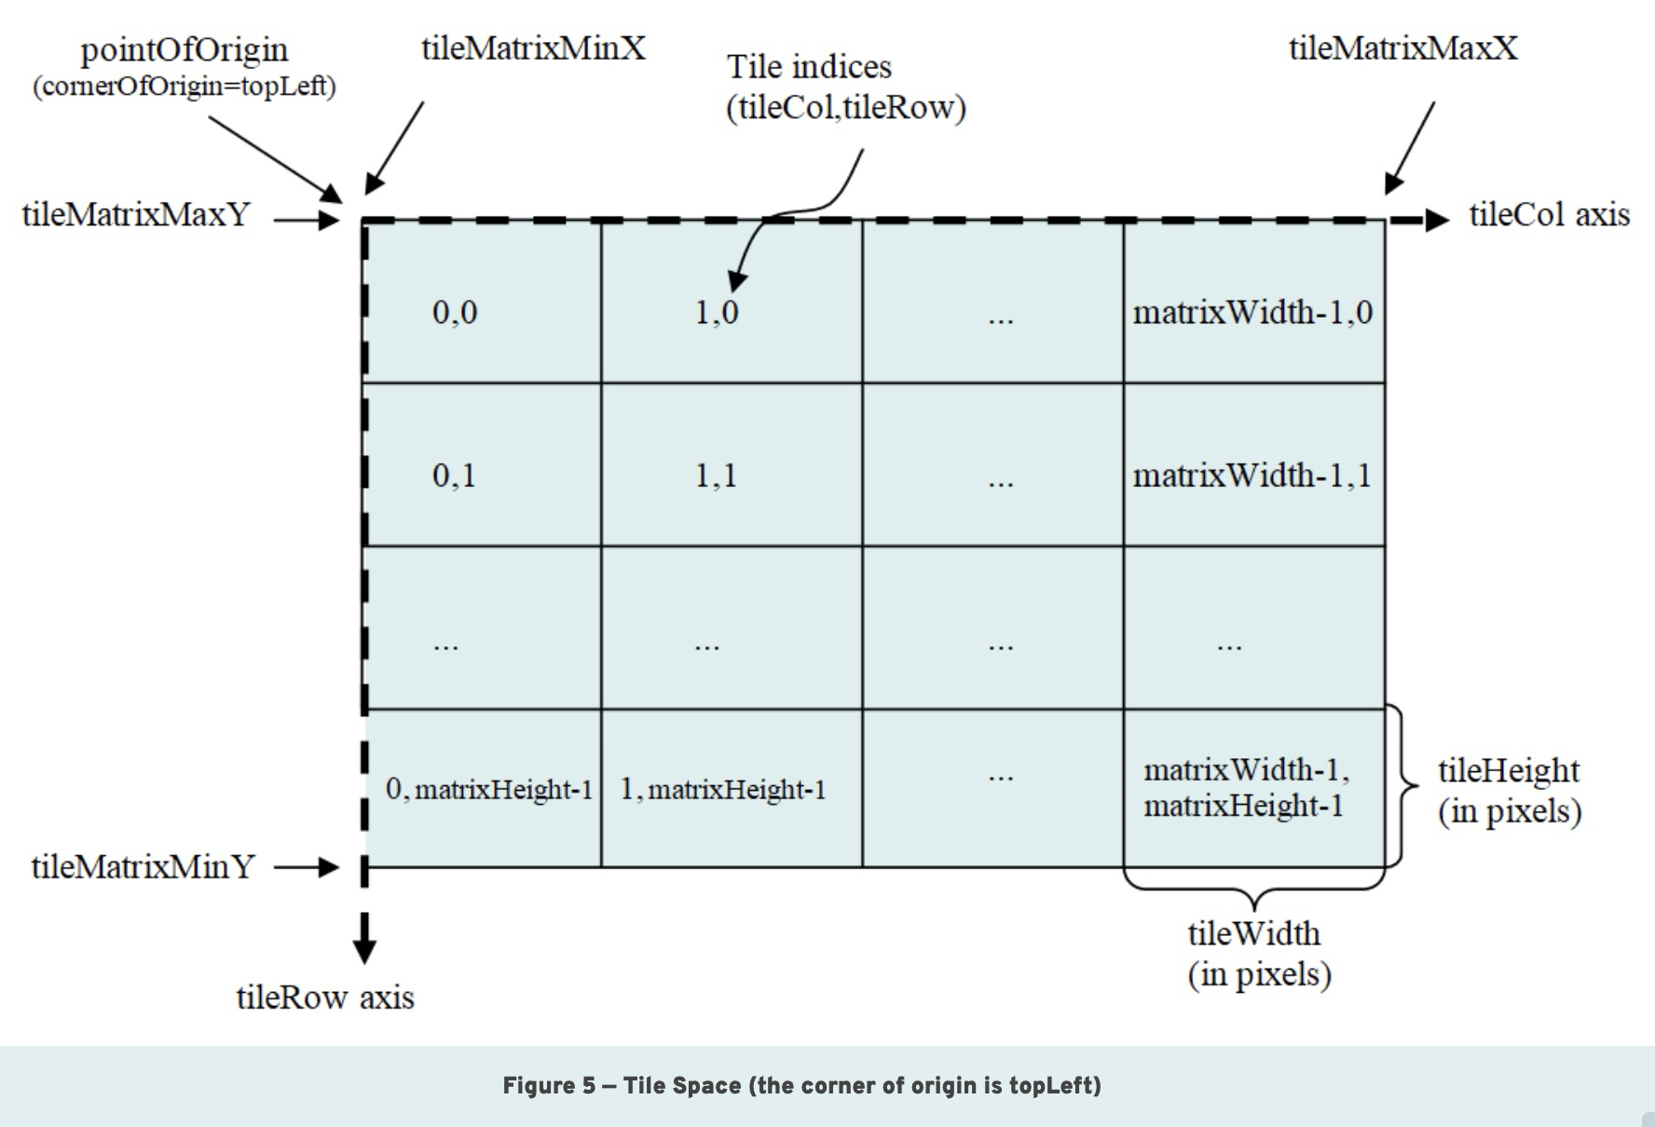
Tile Size /Matrix Size Calculation

Slide 5
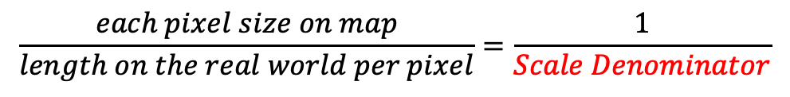
Tile Size /Matrix Size Calculation
Pixel size
$$\frac{each pixel size on map}{length on the real world per pixel}=\frac{1}{Scale Denominator}$$
Tile Size
= 256*256 pixels

Slide 6
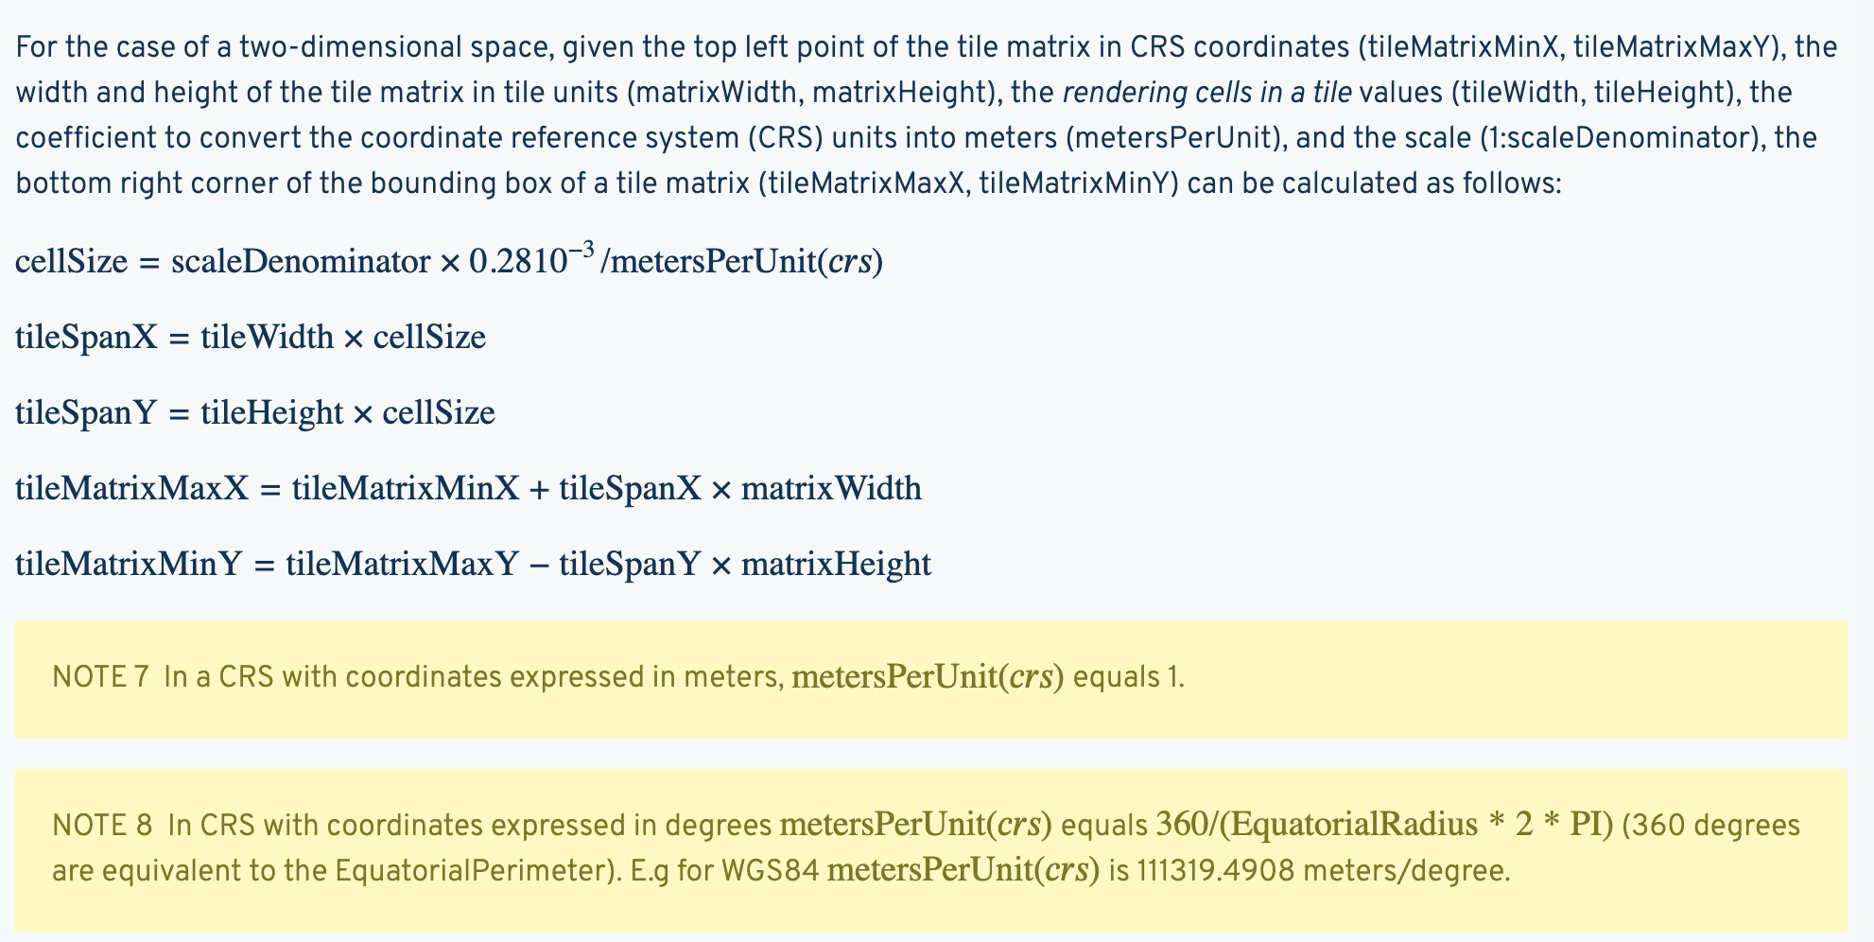
Tile Size /Matrix Size Calculation
We use the tile in Spherical Mercato projection (EPSG:3857)
Rendering pixel: 0.28mm * 0.28mm, tileWidth = 256
tileSpanX = tileWidth * (scaleDenominator * 0.28 * 10⁻³ /metersPerUnit)
= pixel count * pixel size on map * SD
= 256 * 0.28 * 10⁻³ * SD
Since the tile is in Spherical Mercato projection (EPSG:3857), metersPerUnit(crs) equals 1.

Slide 7
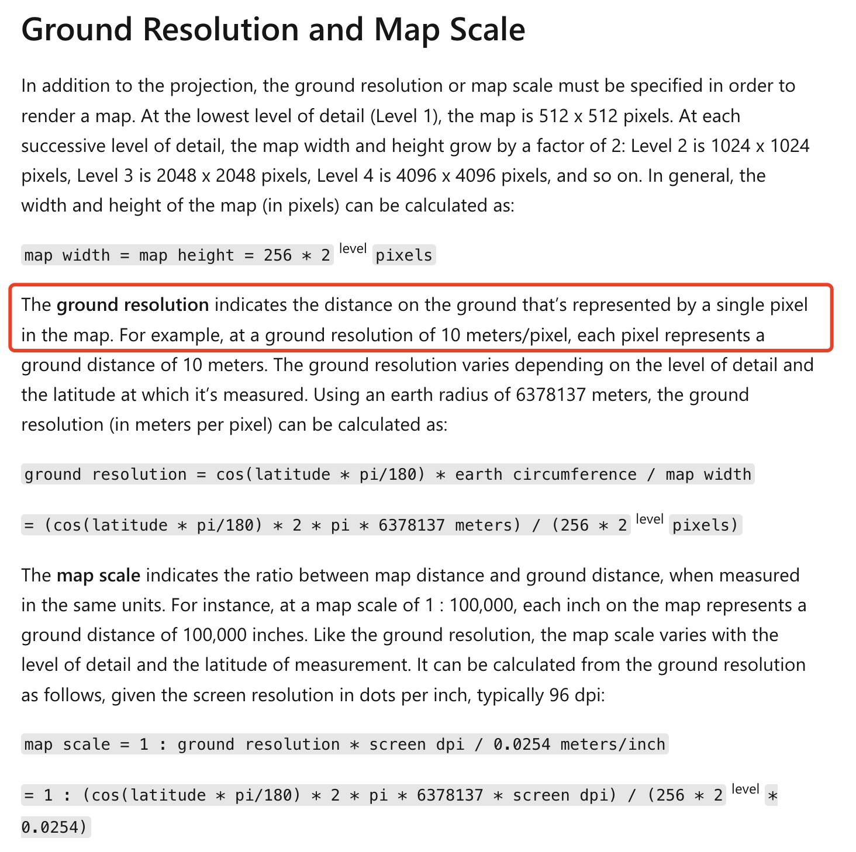
SD = Ground resolution

Slide 8
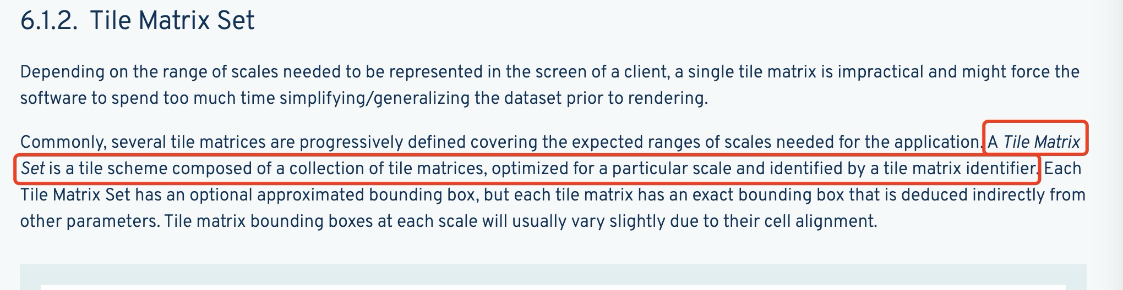
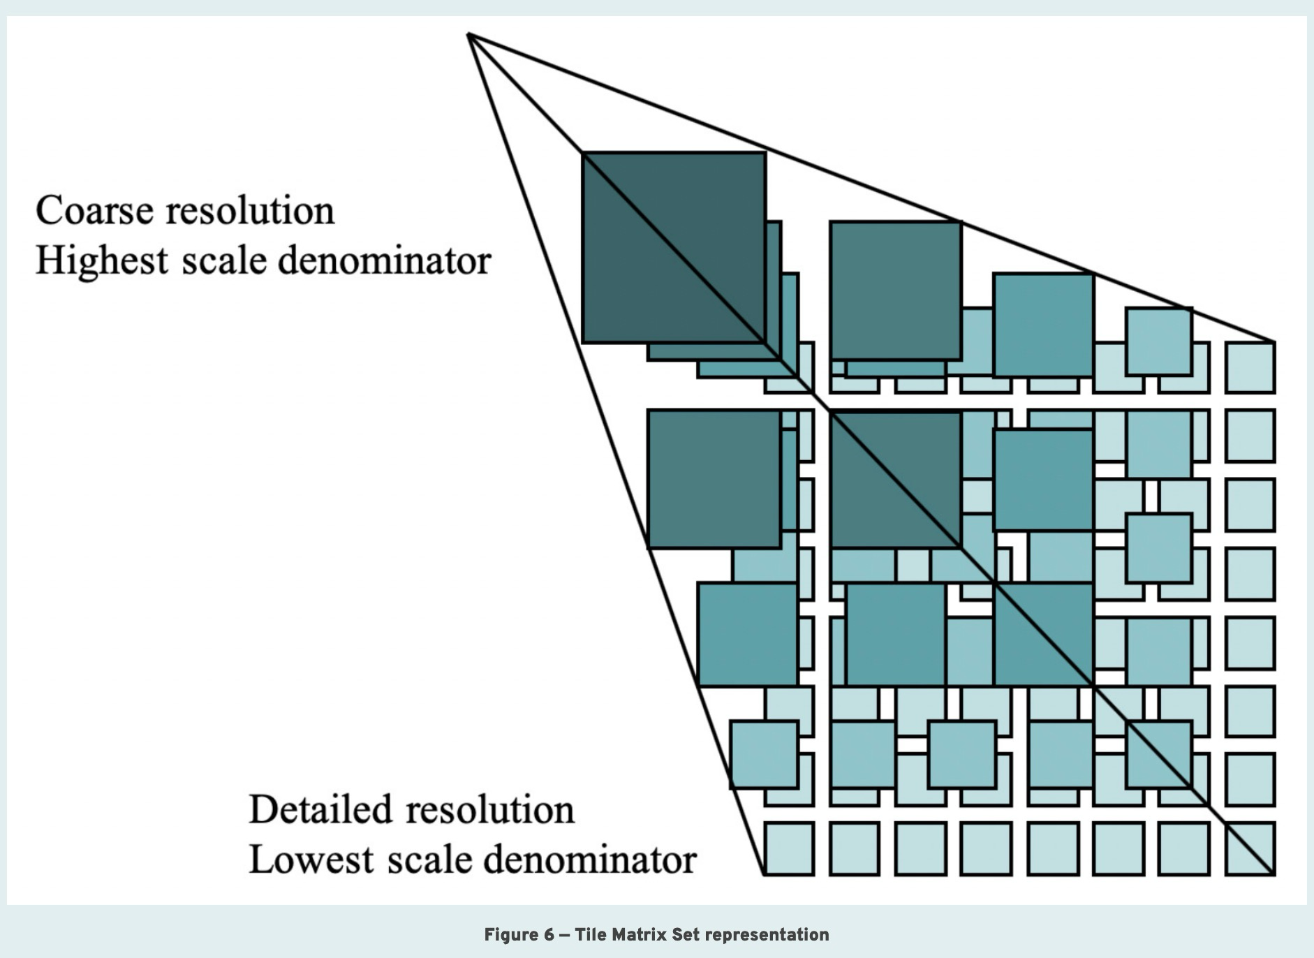
Tile Matrix Set

Slide 9
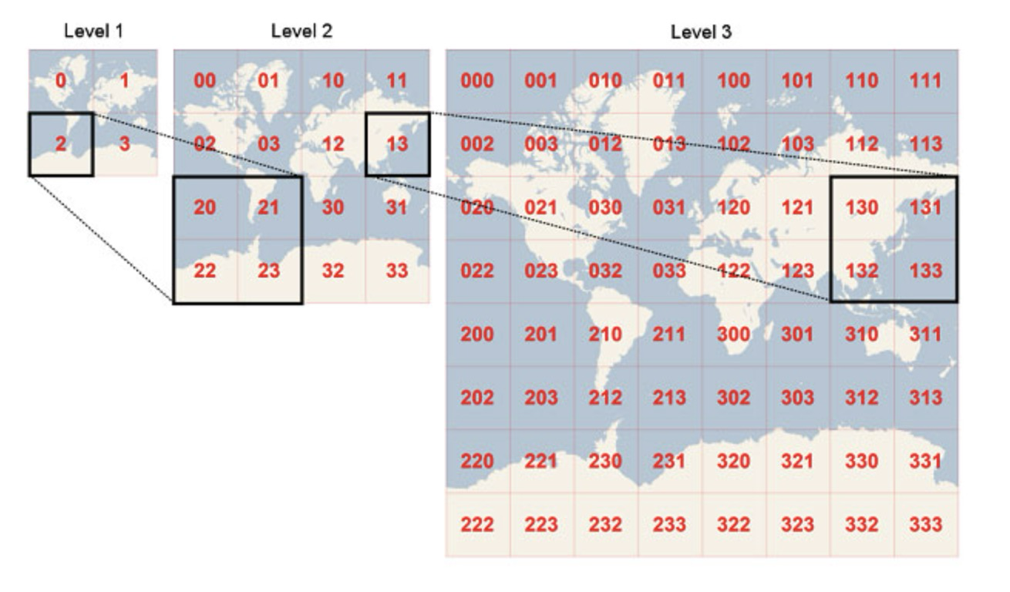
Tile Matrix Set

Slide 10
Workflow of the AI-Driven analysis
Step 1: Get BBOX of each tile given X, Y, Z (refer to Juliet’s code)
https://github.com/PermafrostDiscoveryGateway/viz-info/blob/main/helpful-code/prepocessing/bounding_box_tiles.ipynb
Step 2: Find a library that can generate a heatmap image for polygons (centroid) in this tile.
Step 3: Try to generate tile-based heatmap at different zoom levels
Start from zoom level 15, and go lower ( limit: level 3-4 would be good enough), try different parameters
[Step 4: If our focus is Alaska, how to get which tiles are in Alaska]
Given a bounding box of an area of interest, can the library return which tiles are in Alaska?

Slide 11
Process
Manually choose a latitude and longitude and give a zoom level -> Tile (X, Y, Z)
Get the bounding box of the above tile
Projection transform: Bounding box: 4326 -> Ice wedge polygons: 3413
Query all the centroids of ice wedge polygons (multipolygons) within the bounding box
Generate a heatmap in image format for that tile.
Expand this calculation to all the tiles within northern Alaska for example.

Slide 12
Meeting 8/6/2024
Get BBOX of each tile given X, Y, Z (refer to Juliet’s code) https://github.com/PermafrostDiscoveryGateway/viz-info/blob/main/helpful-code/prepocessing/bounding_box_tiles.ipynb

Slide 13
BBOX & Tiles Matrix
The BBOX (at a specific level) that contains the tile where mouse is located at
All the data within this BBOX is return
The tile at the mouse location
Mouse location

Slide 14
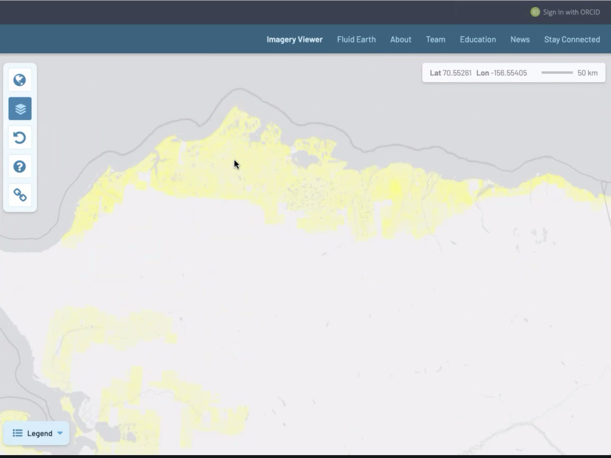
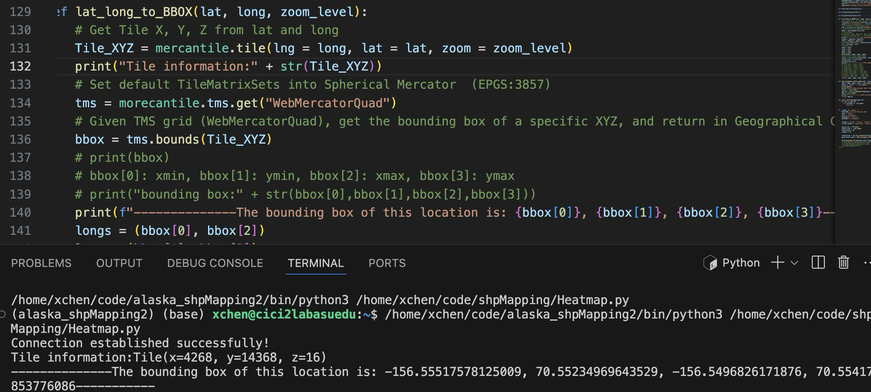
a) Manually choose a latitude and longitude and give a zoom level -> Tile (X, Y, Z) b) Get the bounding box at this locatin

Slide 15
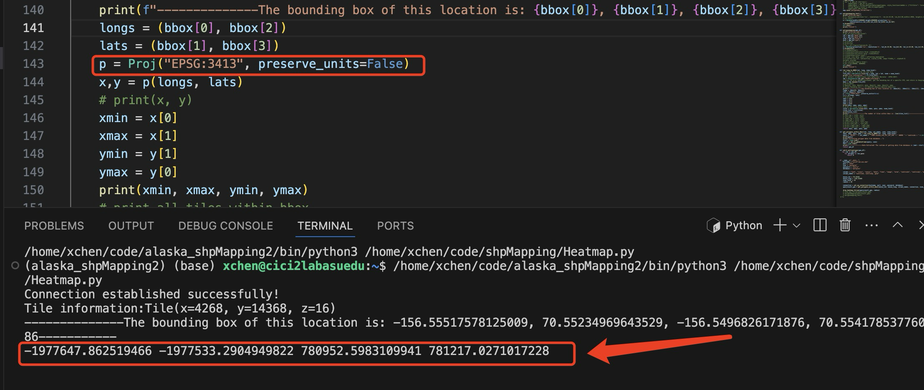
c) Projection transform: Bounding box: 4326 -> Ice wedge polygons: 3413

Slide 16
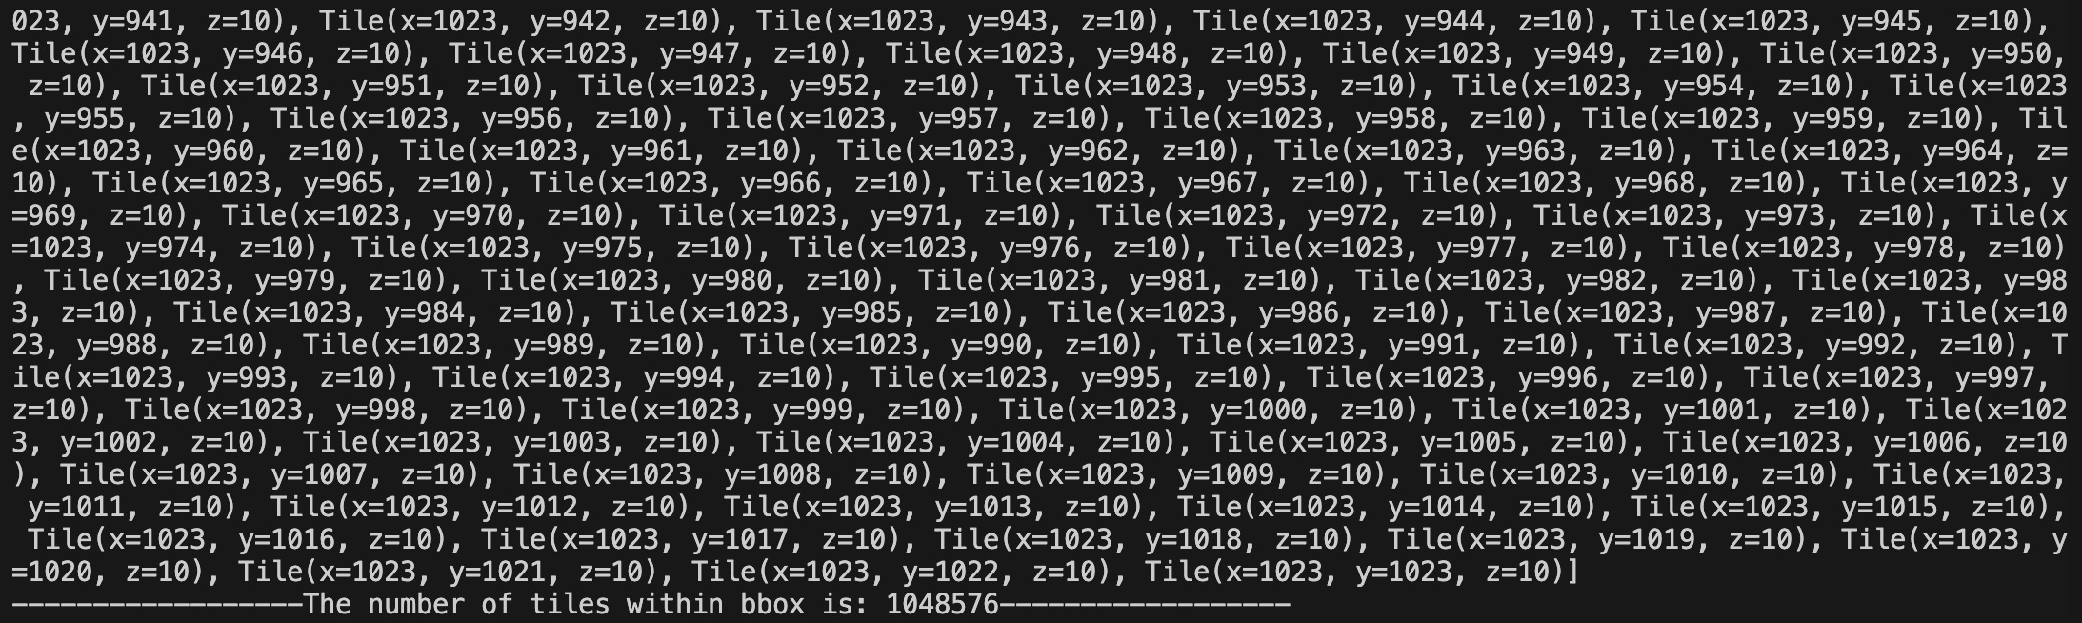
All the tiles within bounding box
X = 4268
Y = 14368
Z = 10

Slide 17
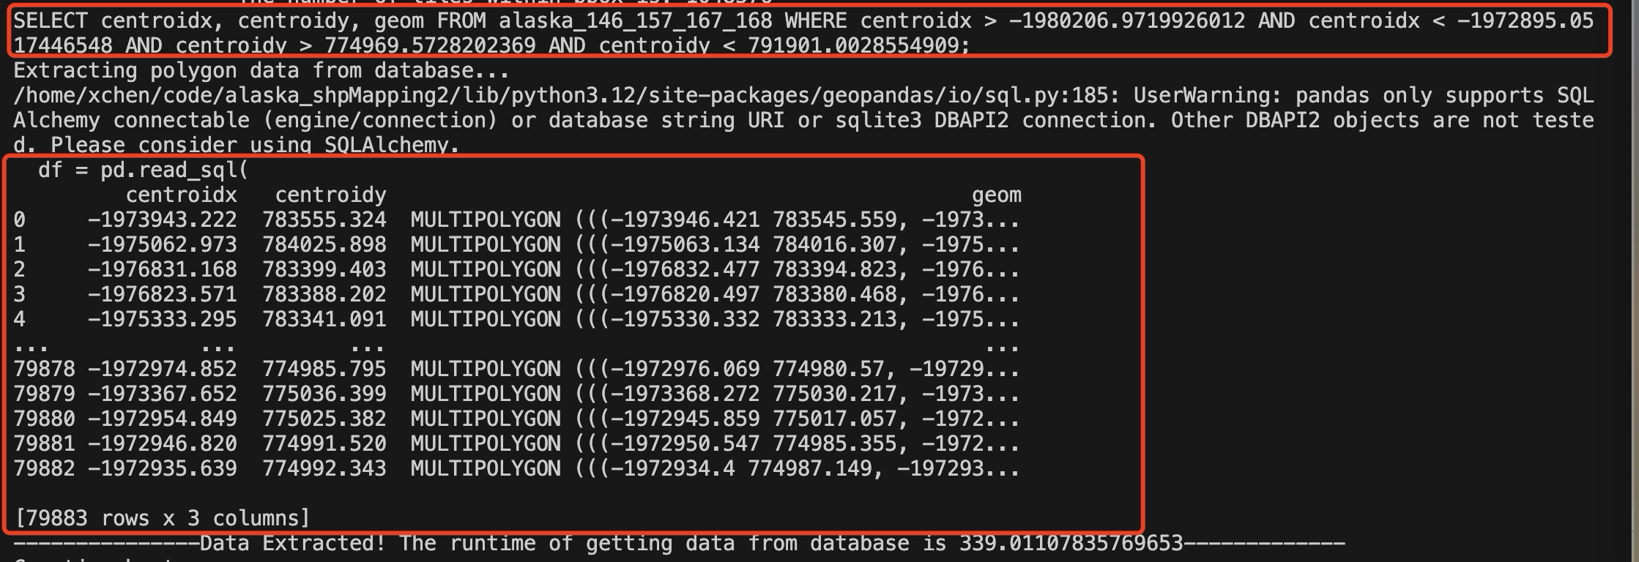
d) Select the centroid of ice wedge polygons (multipolygons) within the bounding box

Slide 18
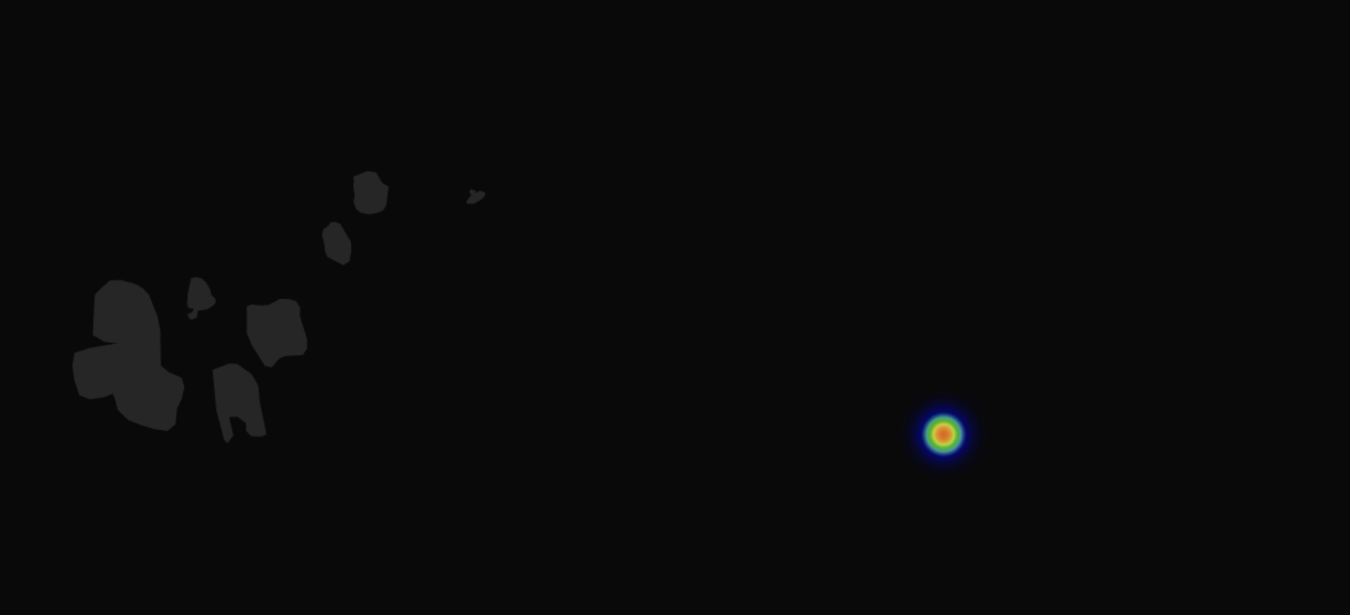
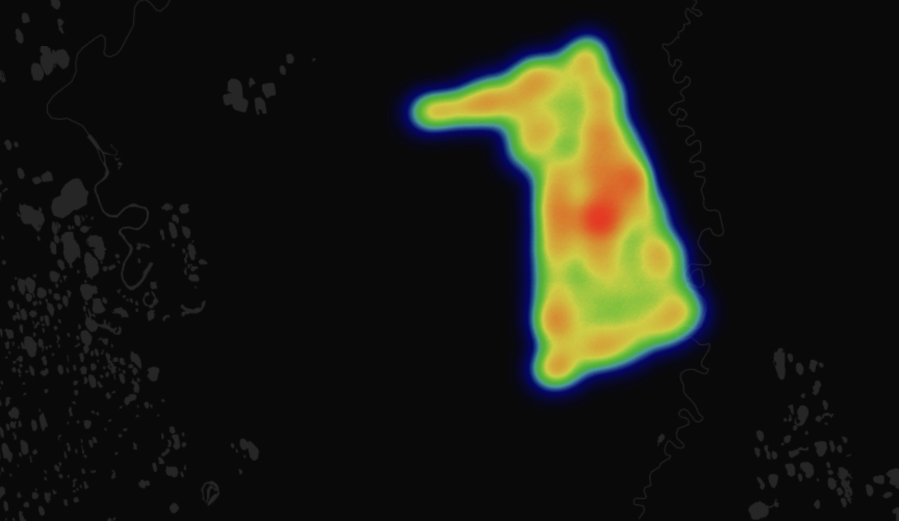
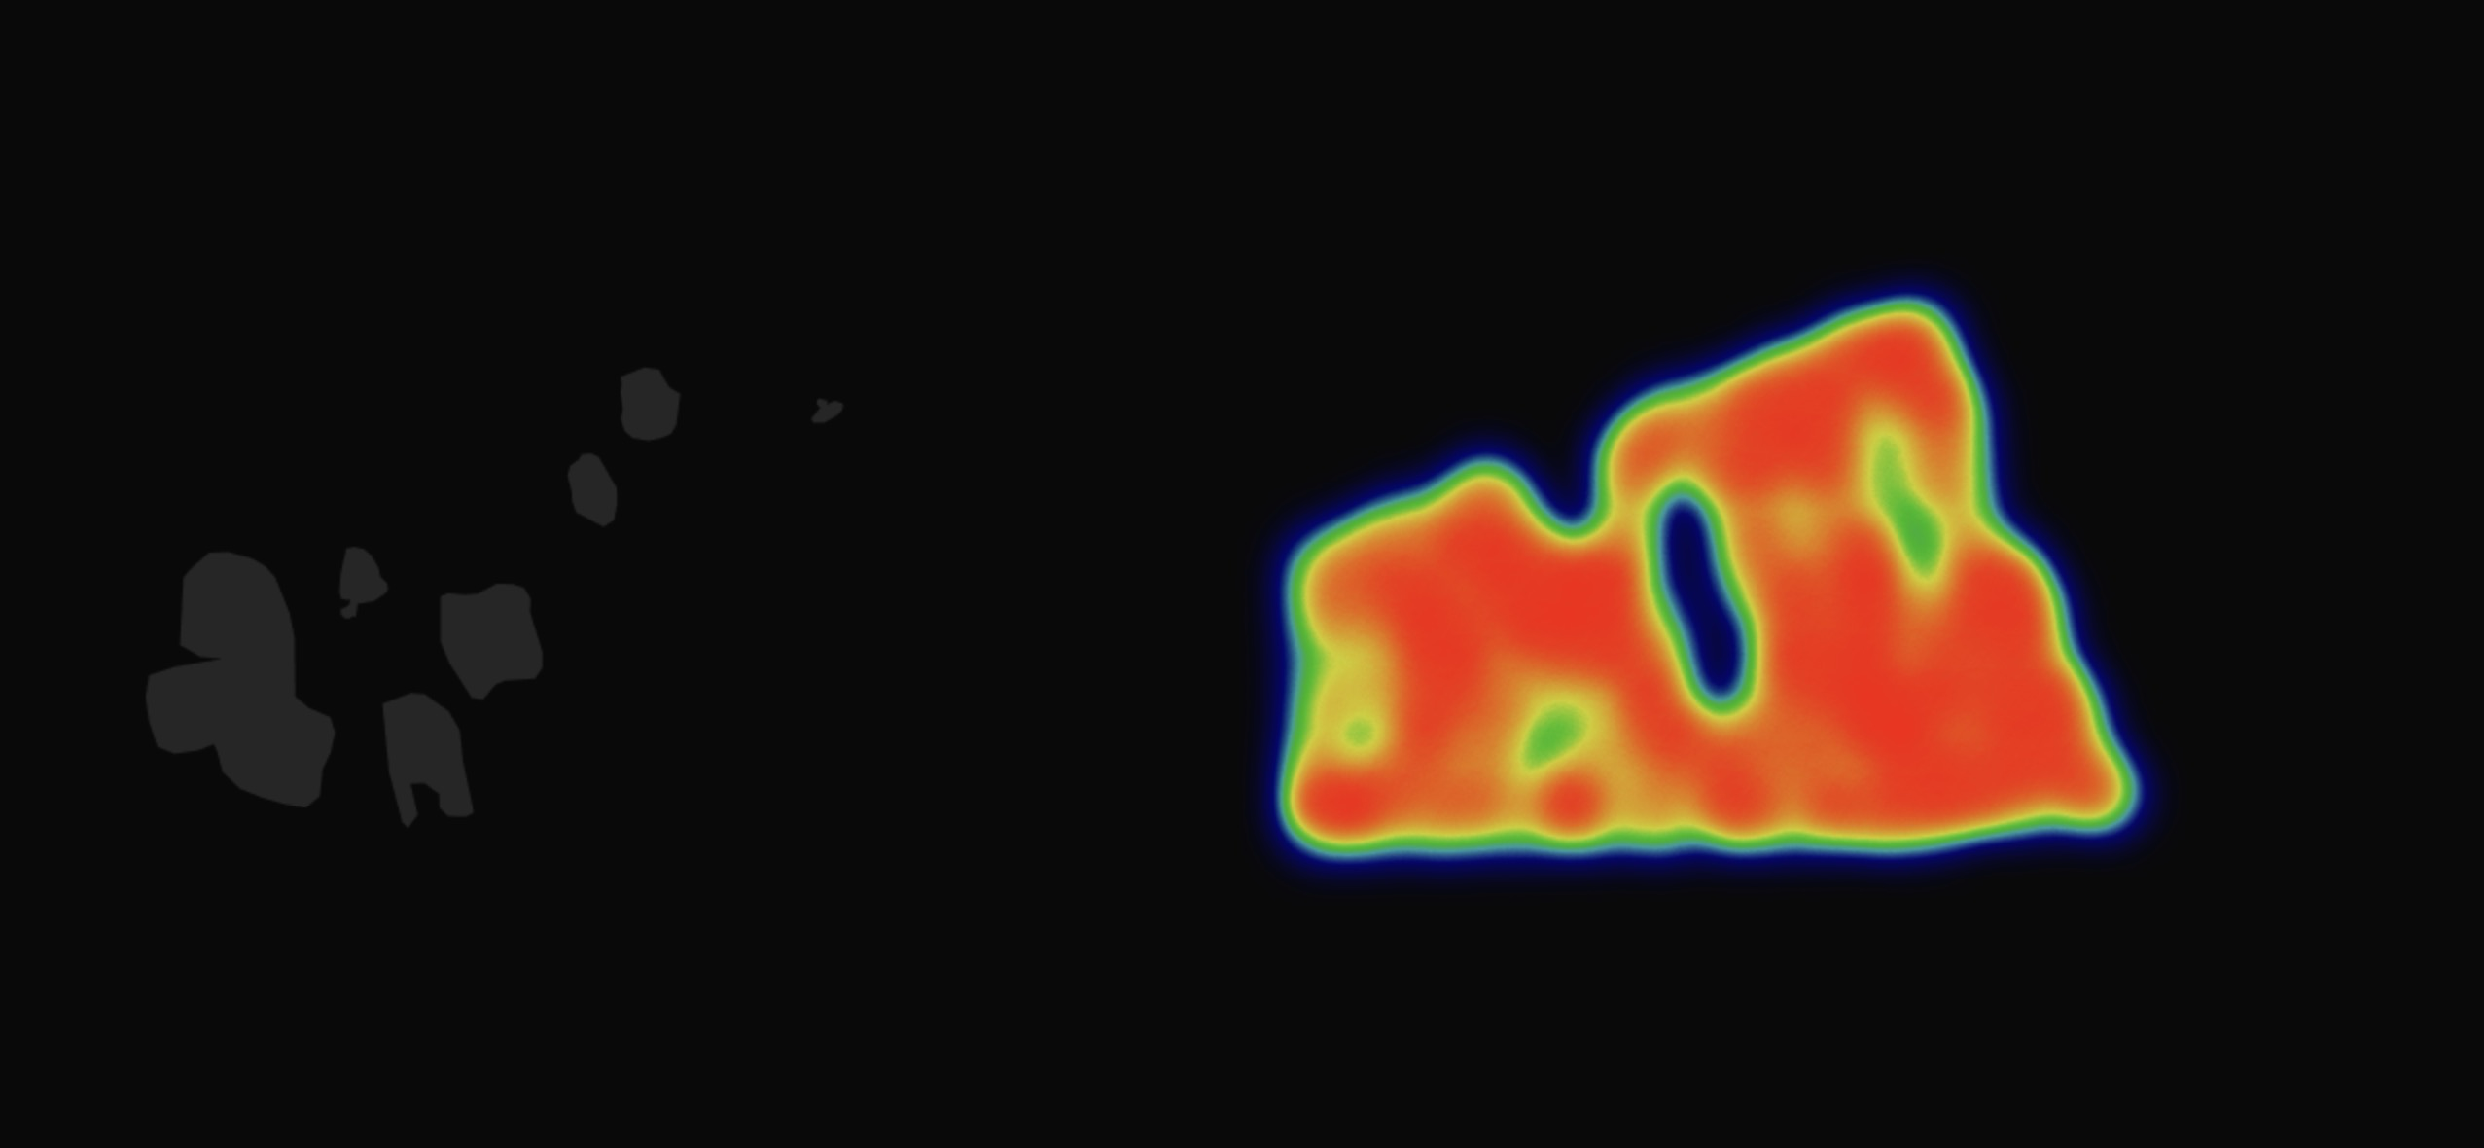
e) Select the centroid of ice wedge polygons (multipolygons) within the bounding box
Zoom level : 16
Zoom level: 8, Tile count: 65,536
x=4268, y=14368, z=16
The bounding box of this location is: -156.55517578125009, 70.55234969643529, -156.5496826171876, 70.55417853776086
x=66, y=224, z=10
The bounding box of this location is: -156.79687500000009, 70.49557354093146, -156.44531250000006, 70.61261423801933
x=16, y=56, z=8
The bounding box of this location is: -157.50000000000003, 70.14036427207168, -156.09375000000003, 70.61261423801925
Zoom level: 10, Tile count: 1,048,576

Slide 19
Meeting (8/13/2024)
Single Tile heatmap (png format / folium)
Multiple Tile heatmap (png format / folium)

Slide 20
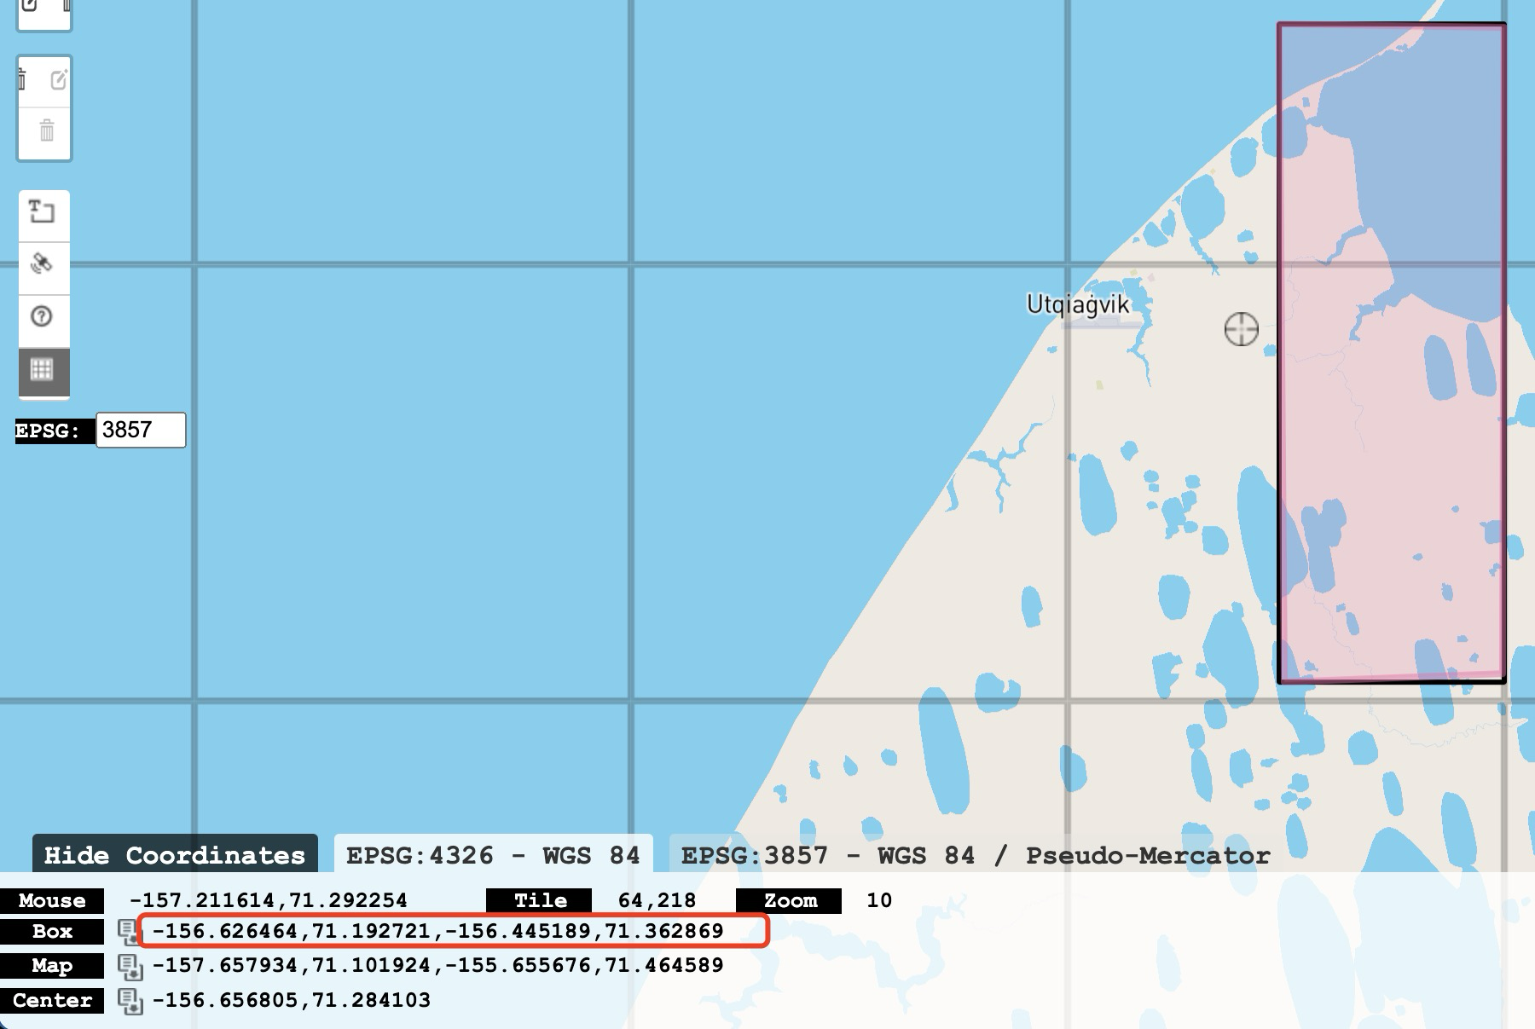
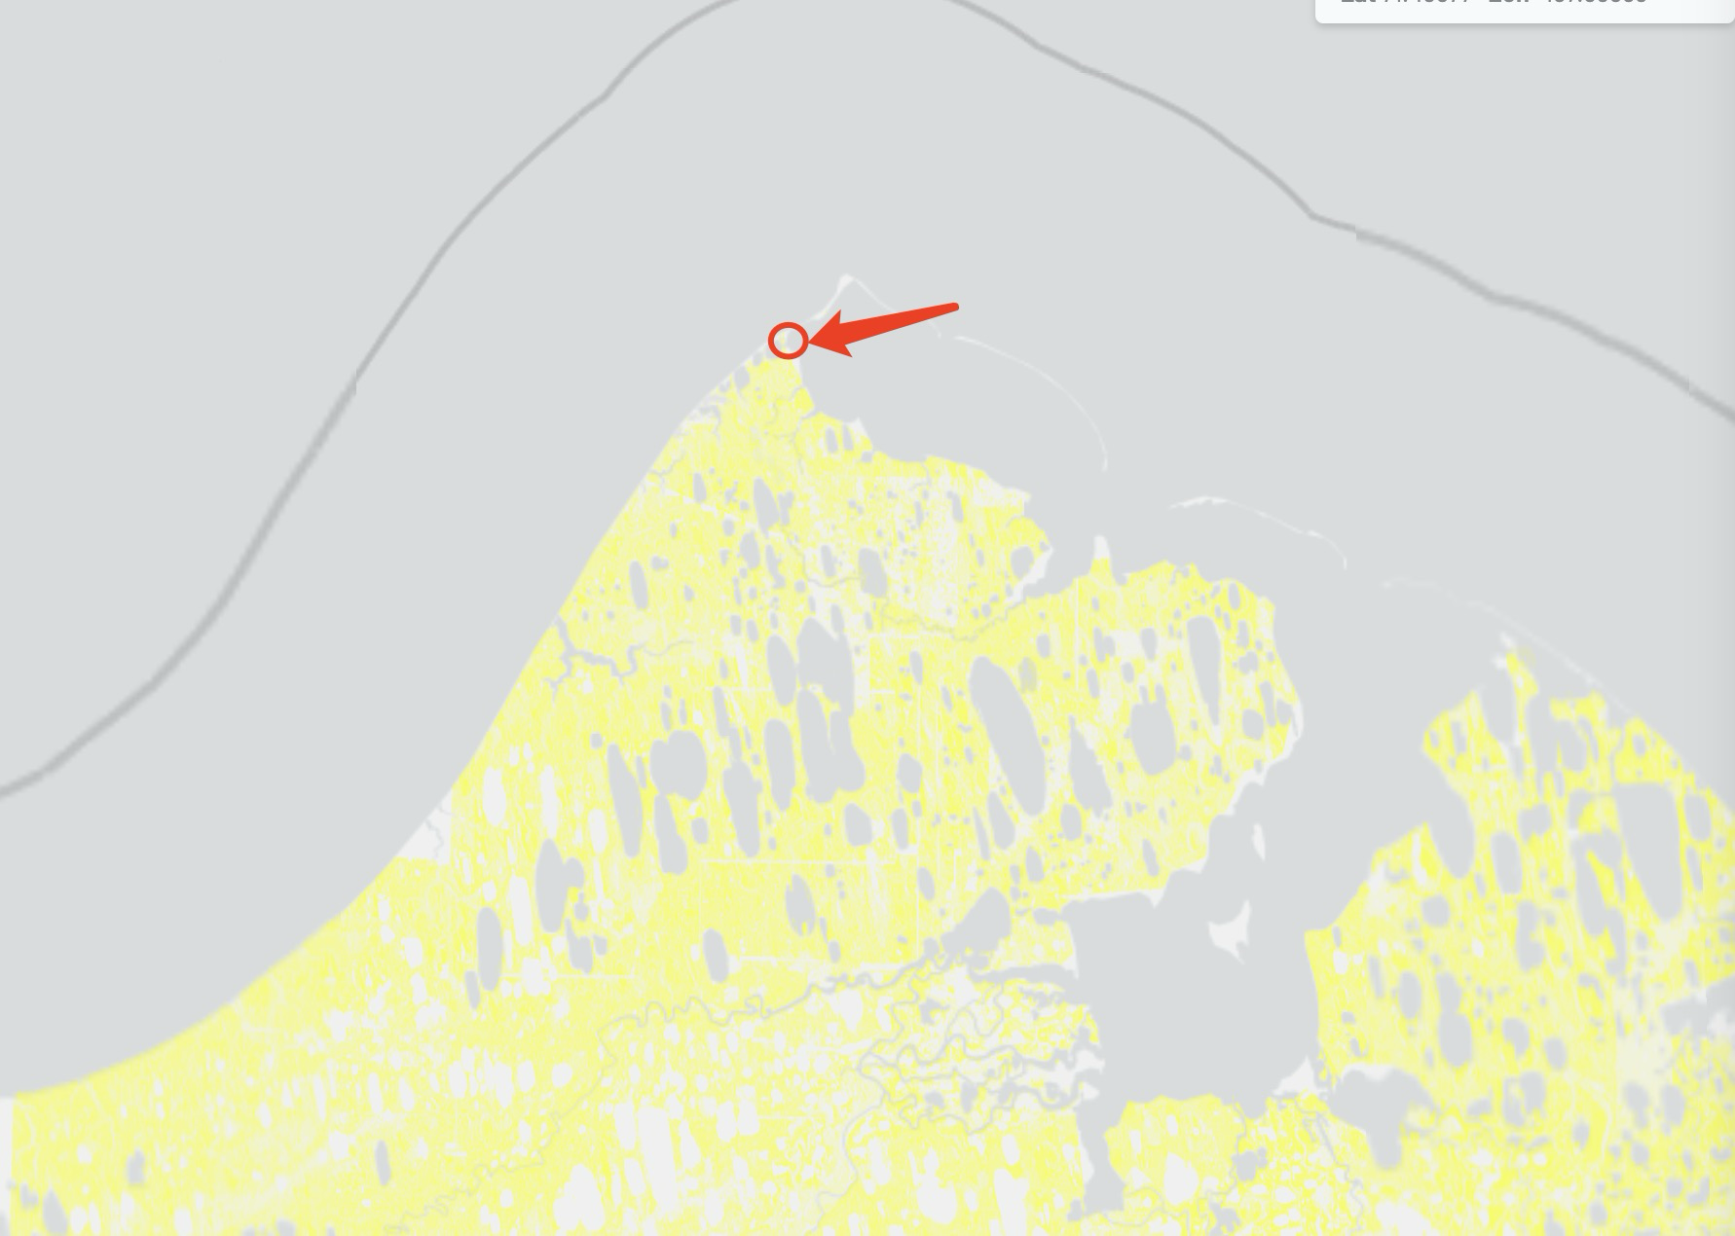
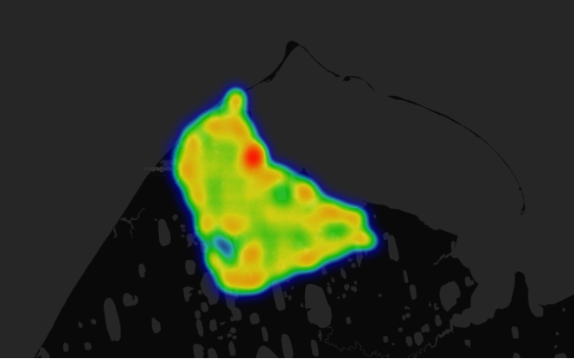
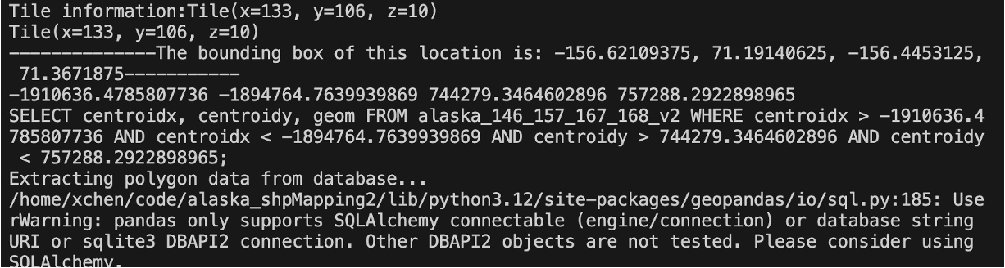
Single Tile Heatmap
Using morecantile: project to WGS84 (WGS1984Quad)

Slide 21
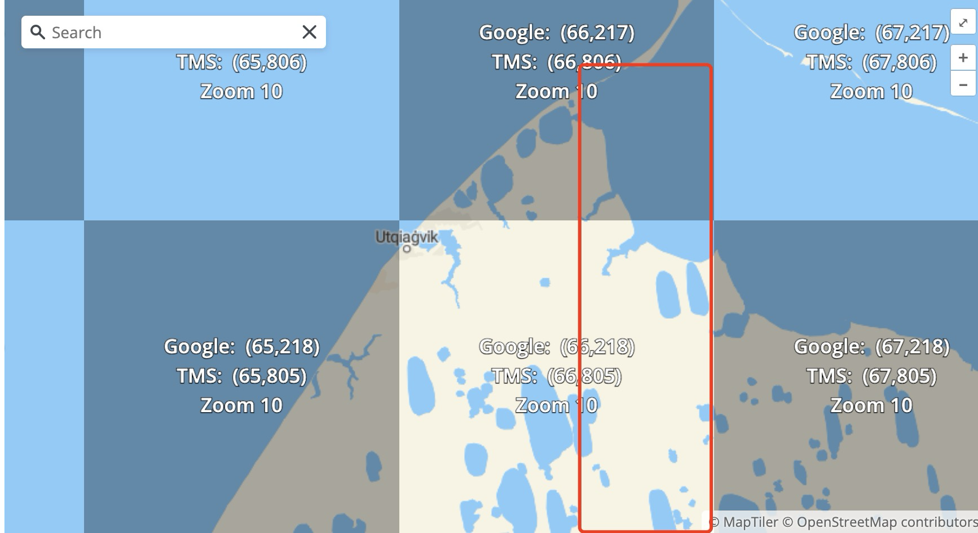
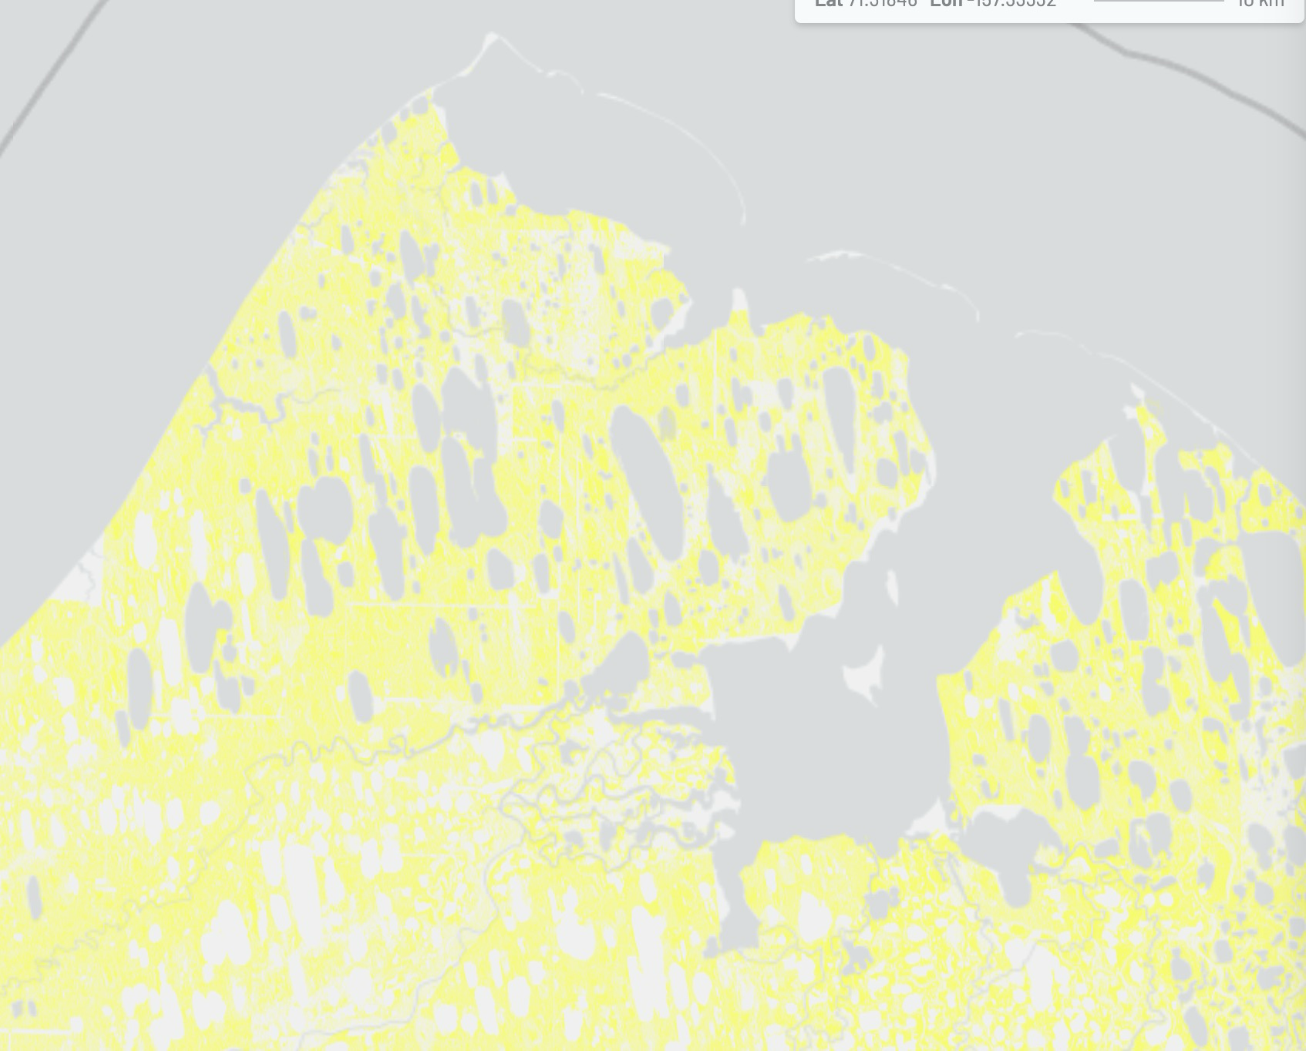

Slide 22
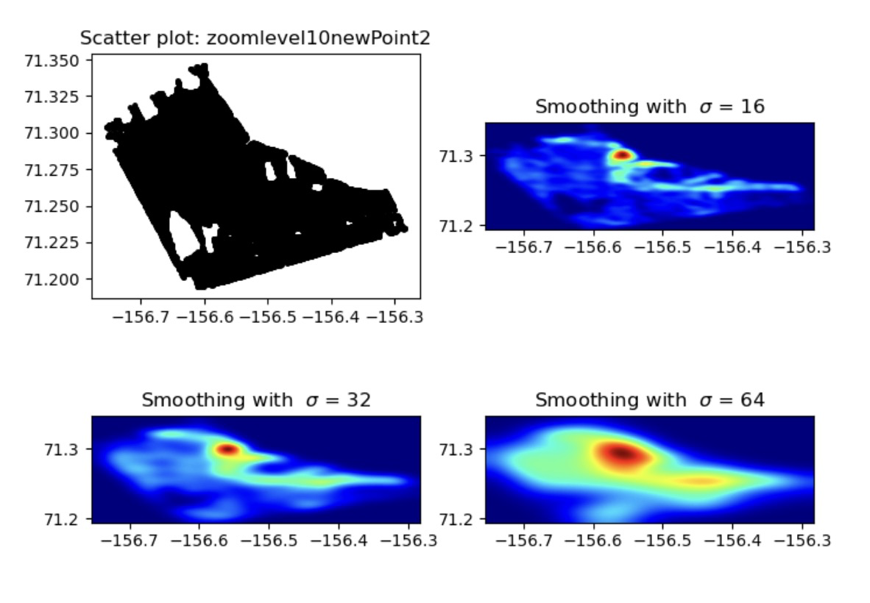
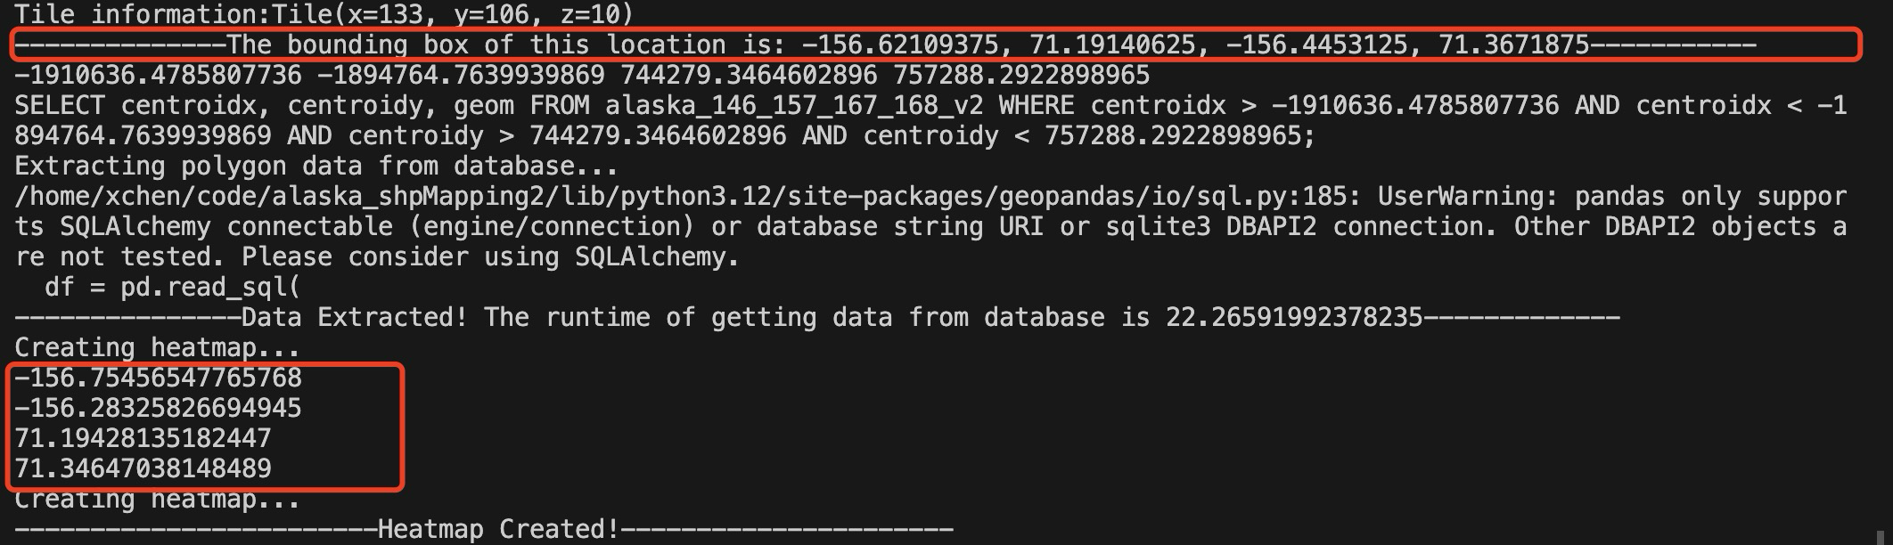
Some of the points are outside of BBOX

Slide 23
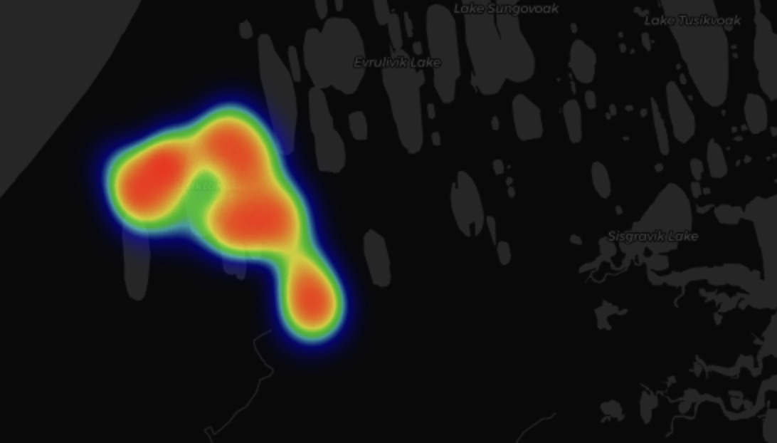
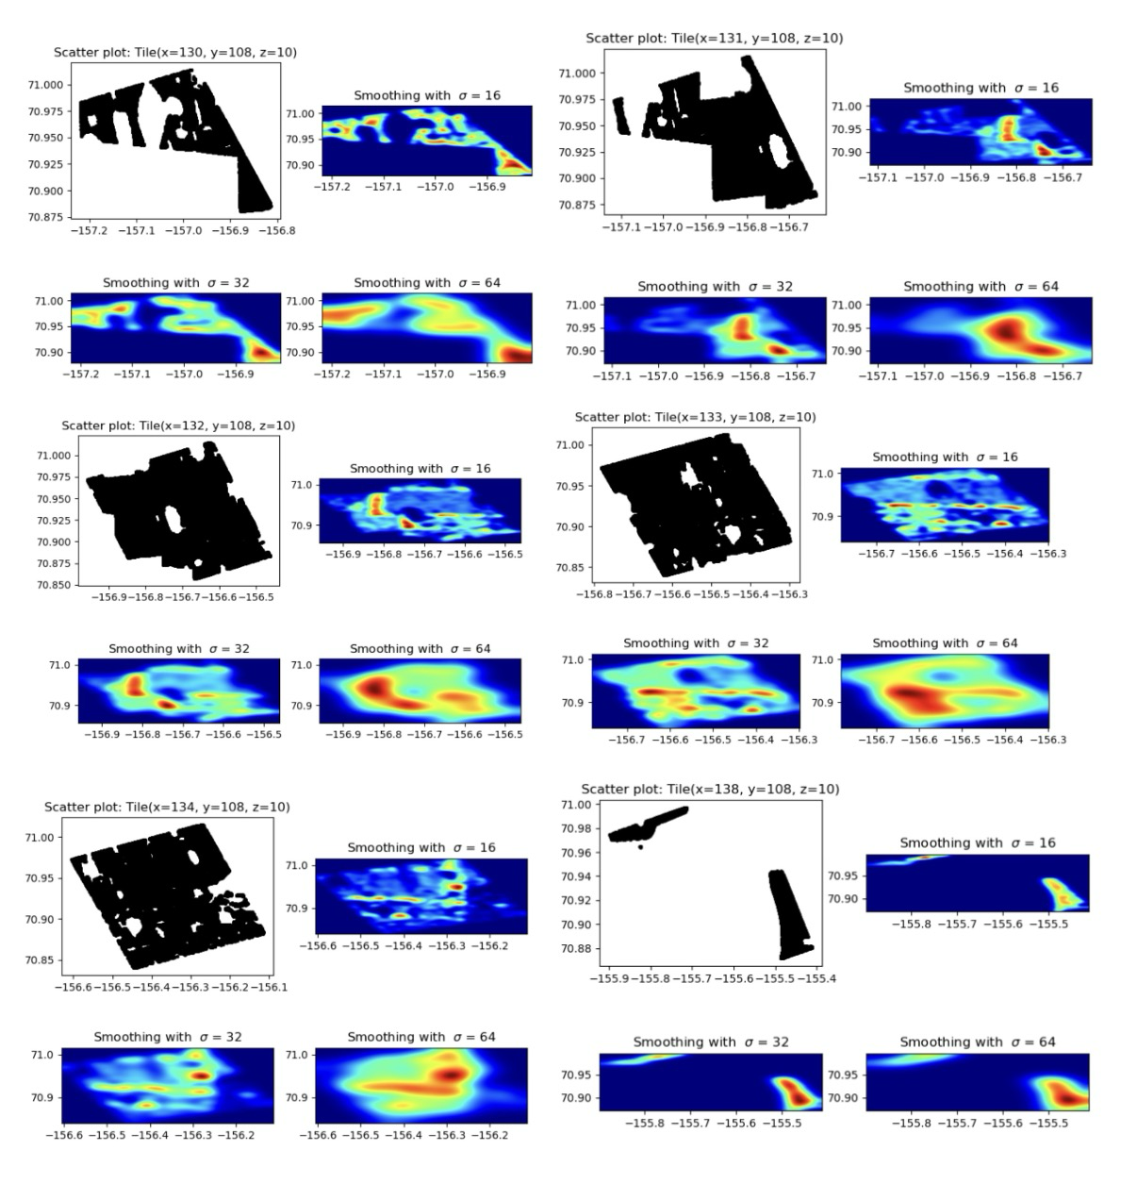
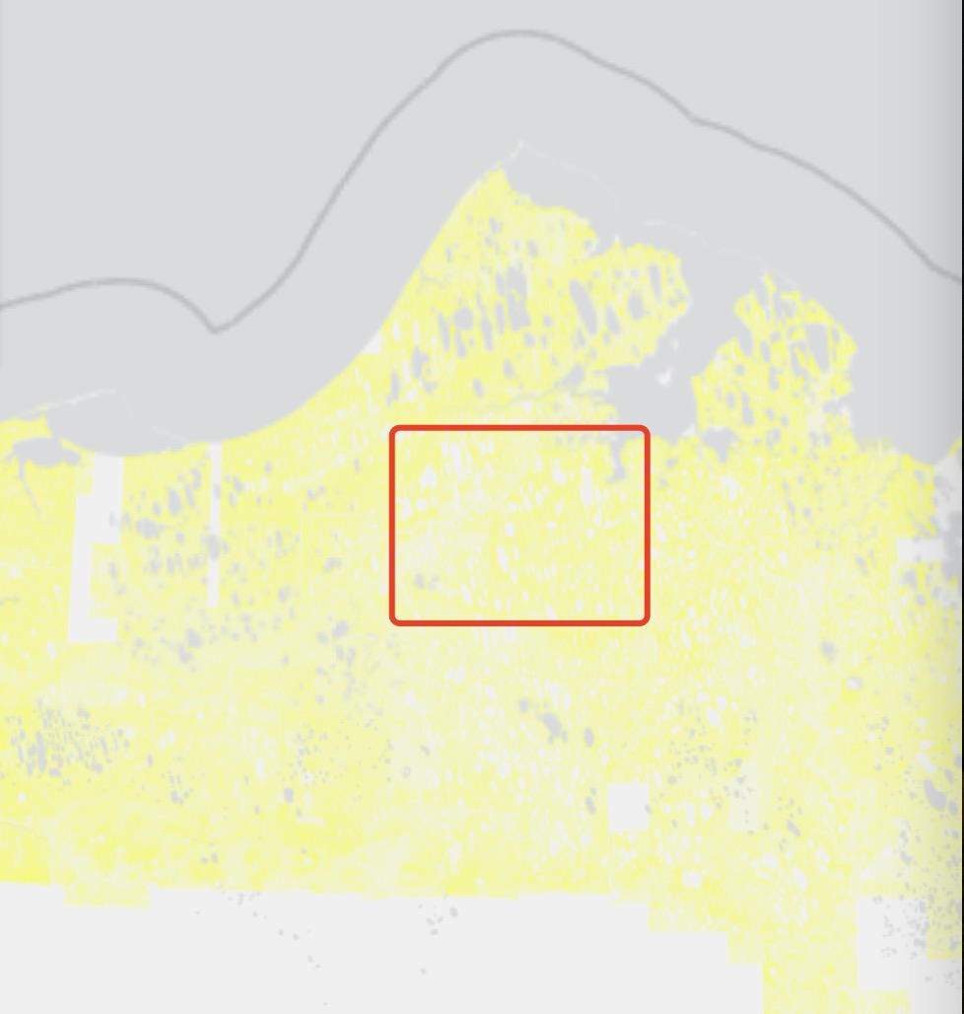
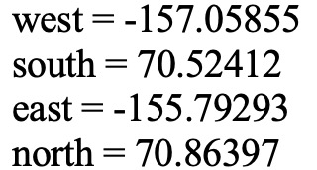
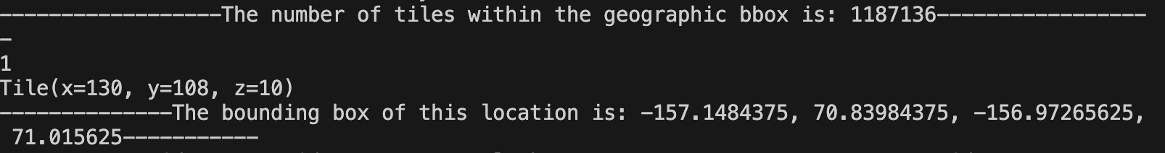
Multiple Tile heatmap
Using morecantile: project to WGS84
(WGS1984Quad)

Slide 24
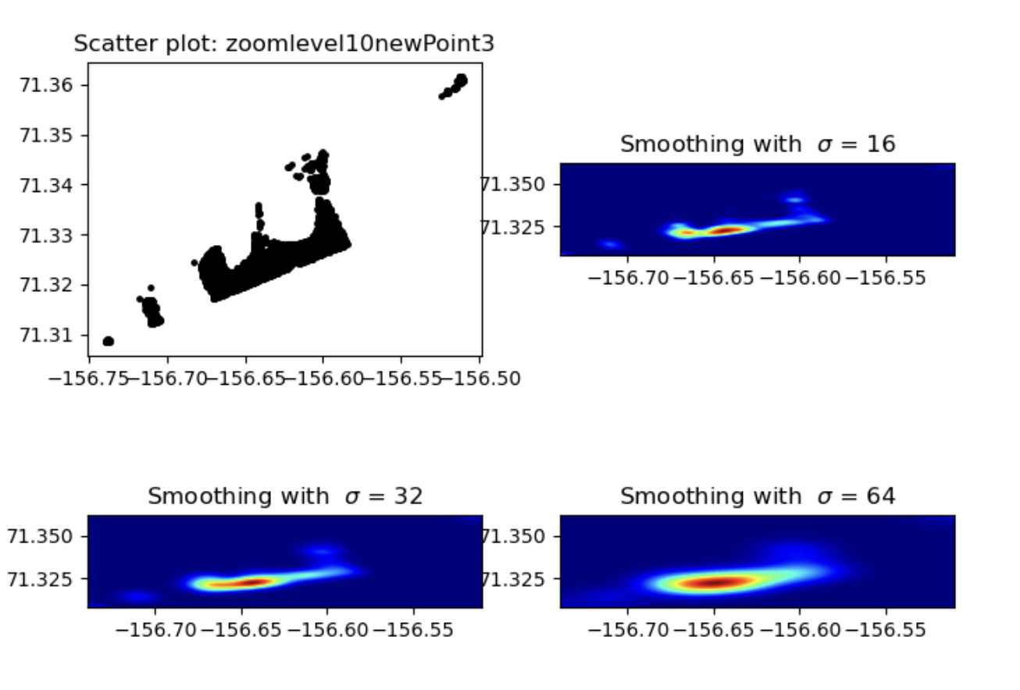
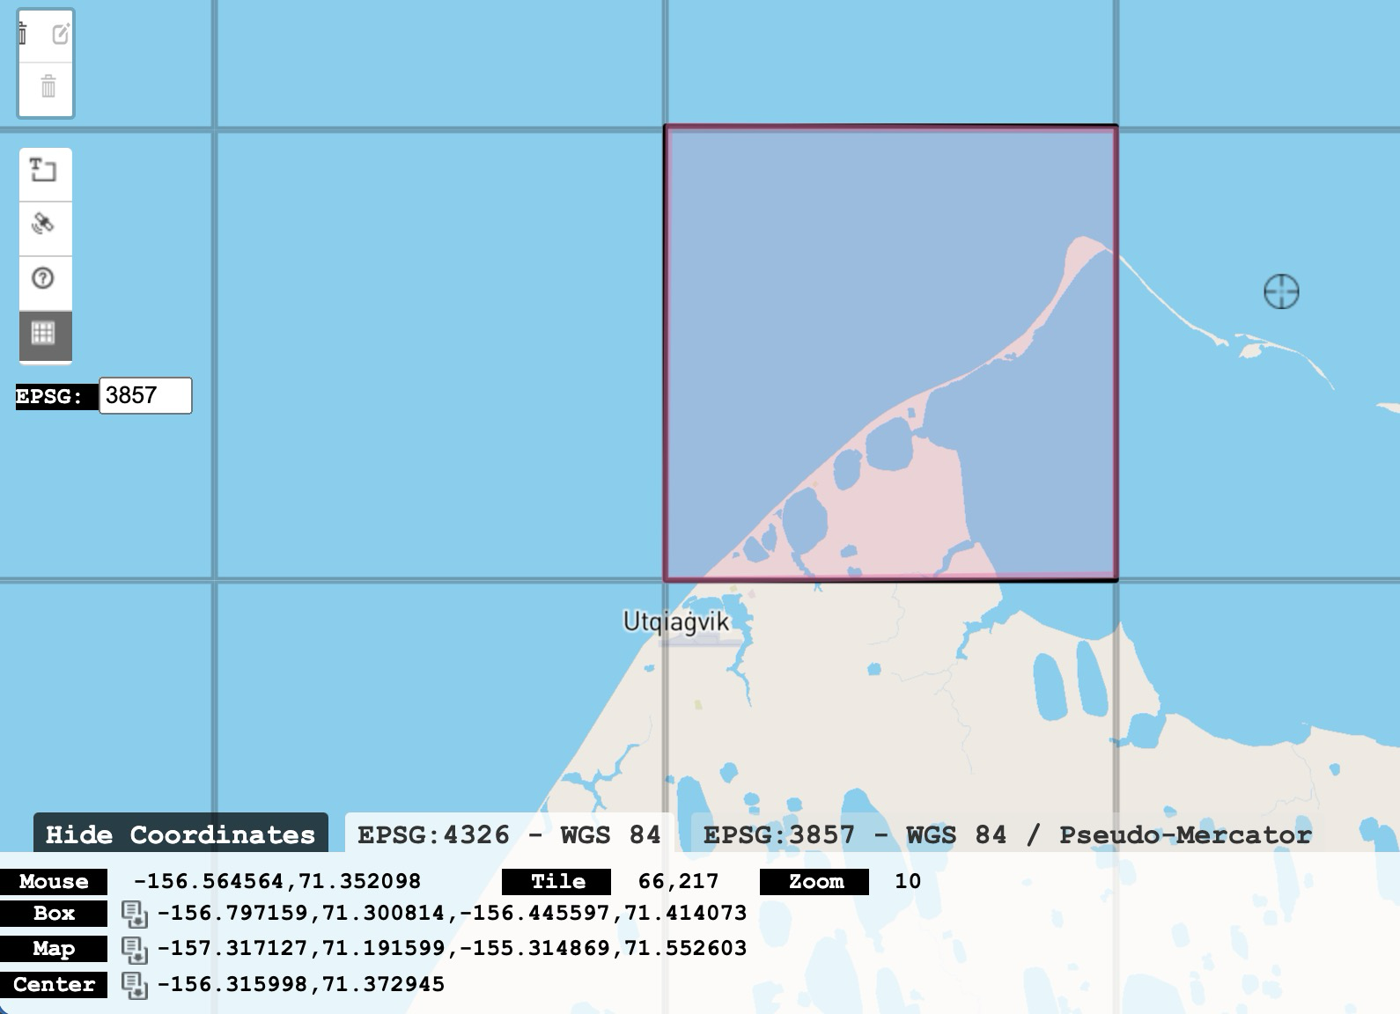
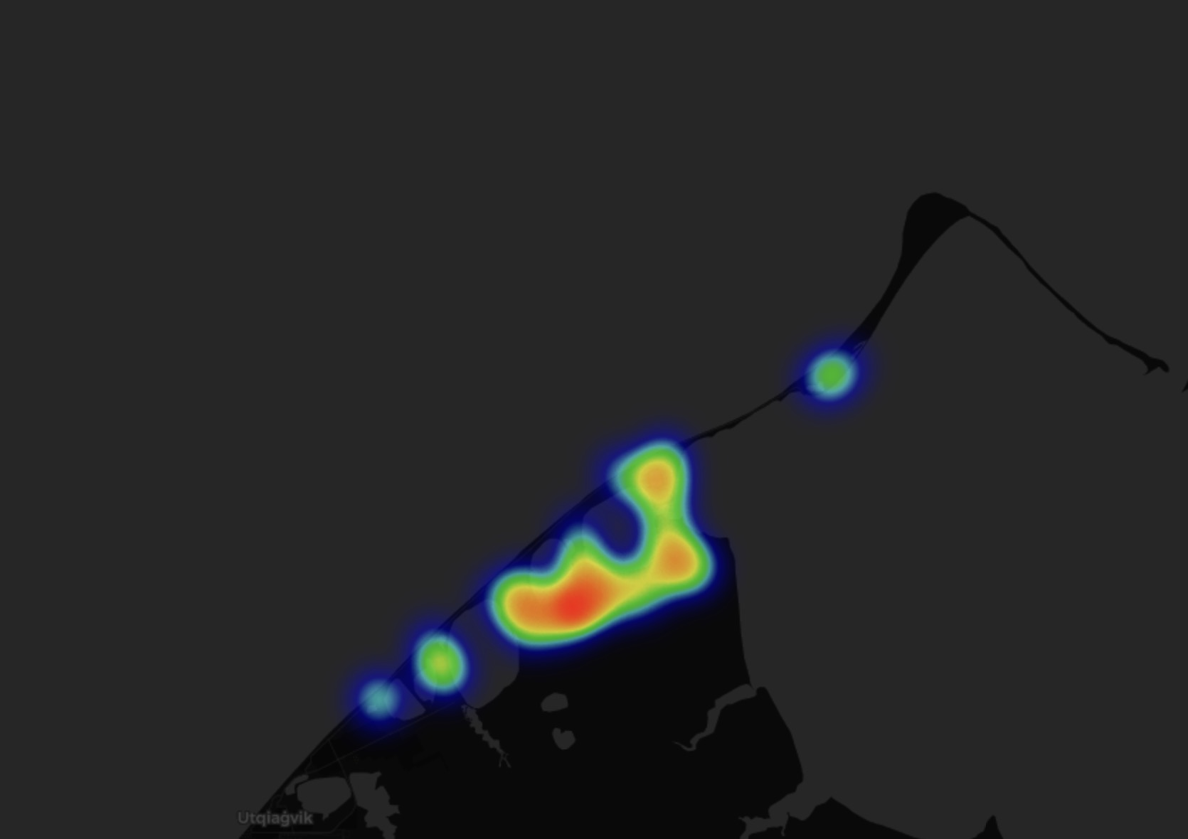
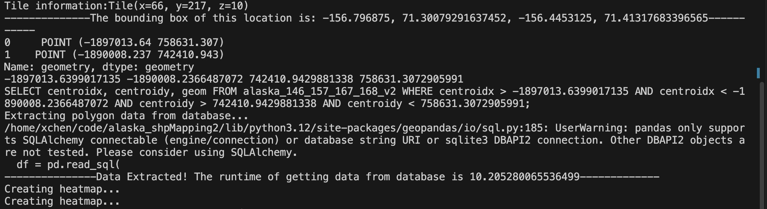
Single Tile Heatmap
Using morecantile: project to EPSG:3857 (WebMercatorQuad)

Slide 25
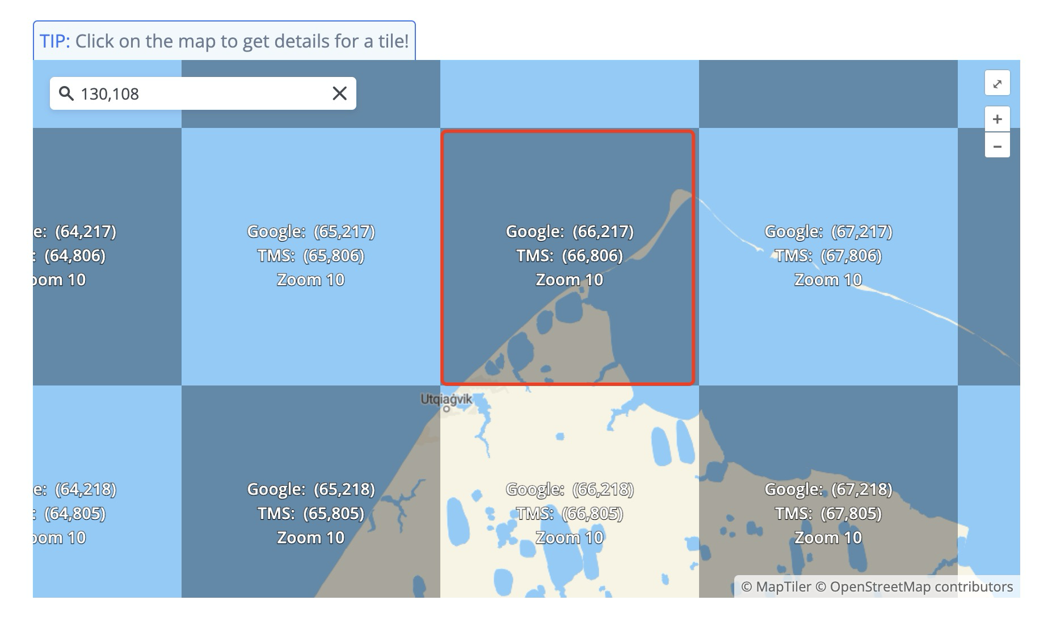
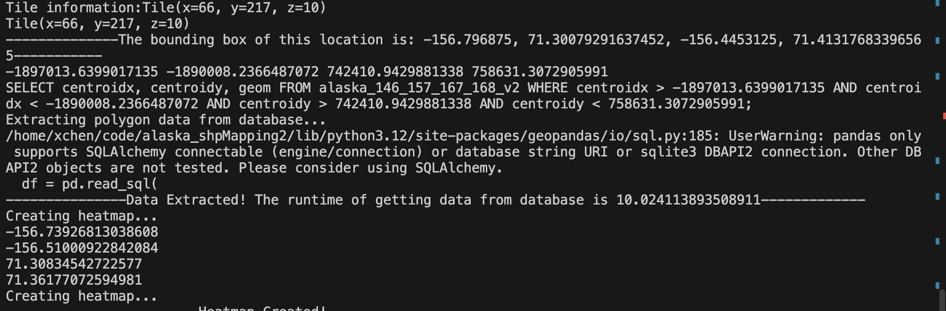
Single Tile Heatmap
Using mercantile

Slide 26
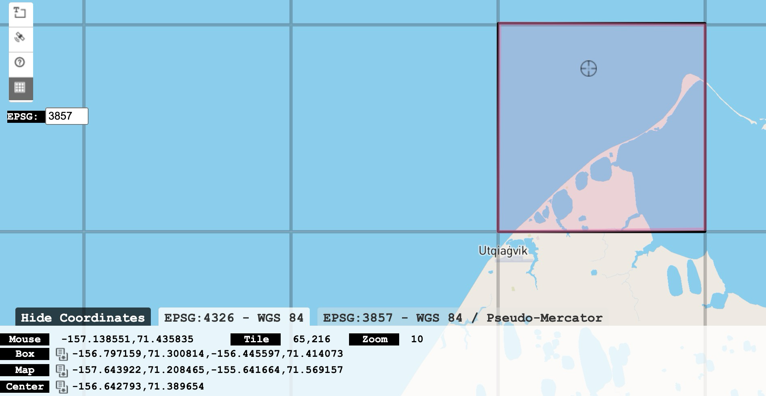
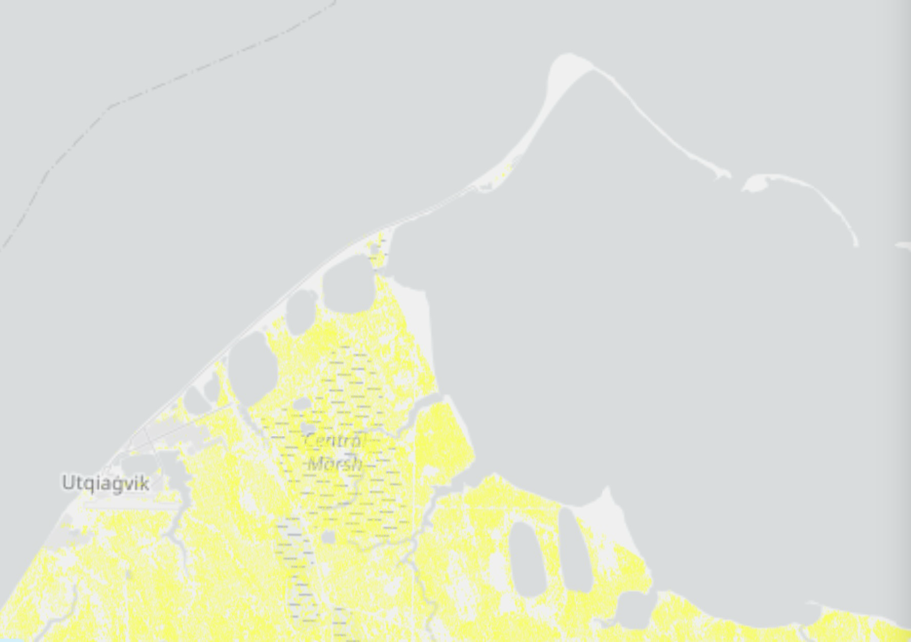
Using mercantile and Proj

Slide 27
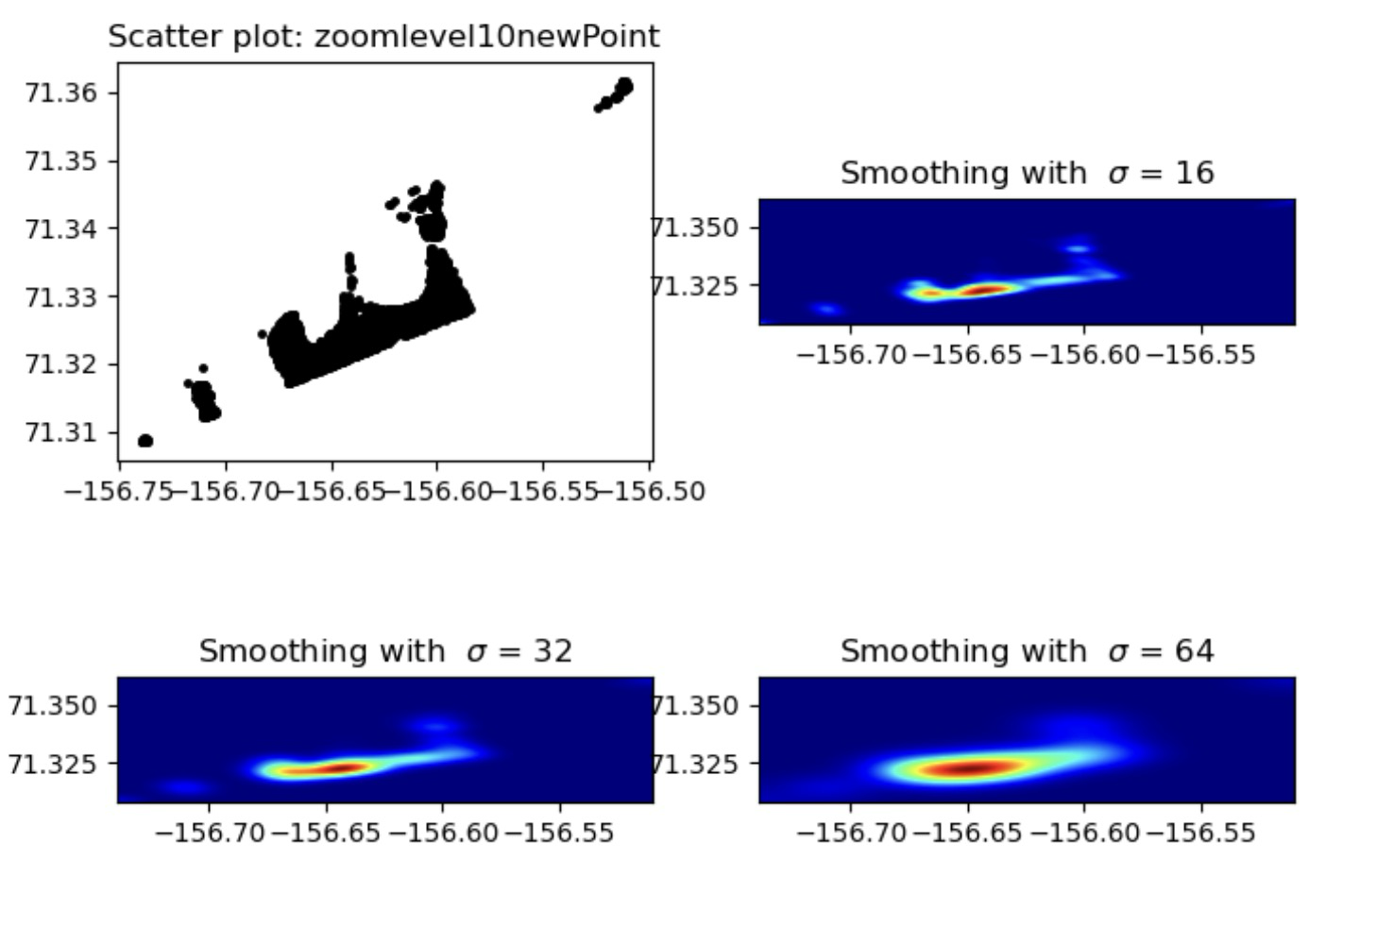
Only parts of data are shown

Slide 28
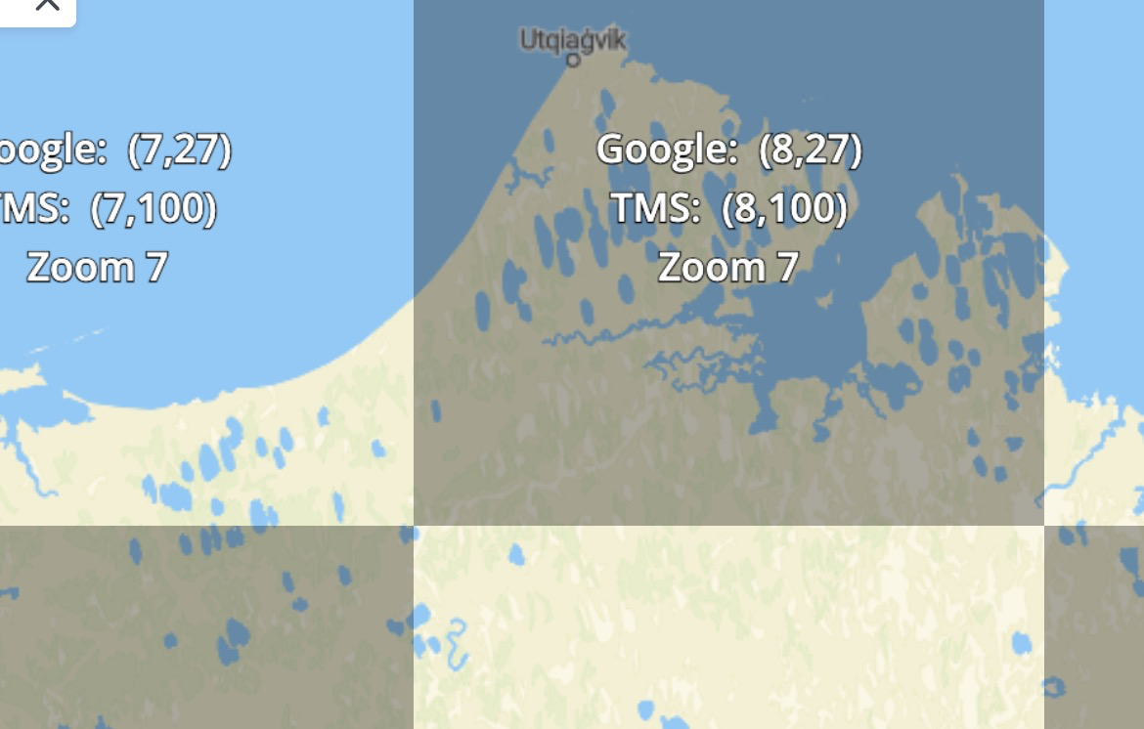
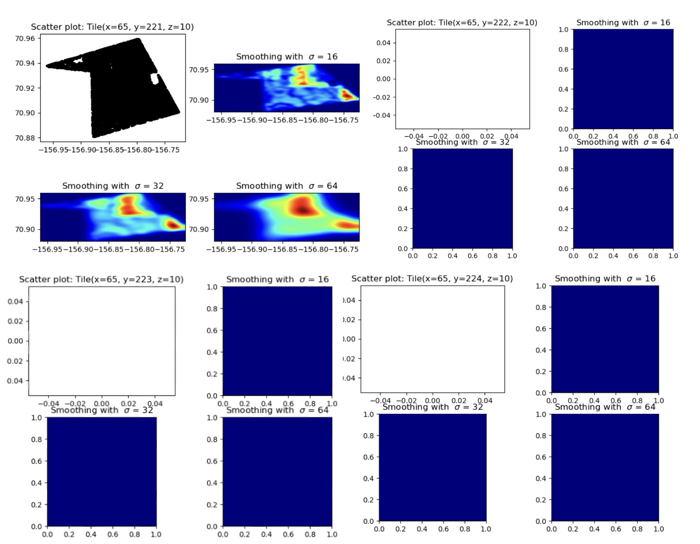
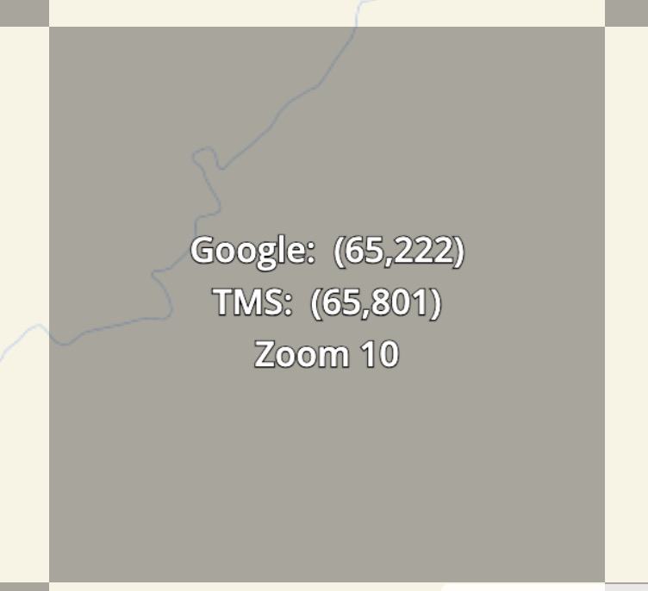
Multiple Tiles Heatmaps
ROI Bounding box:

Slide 29
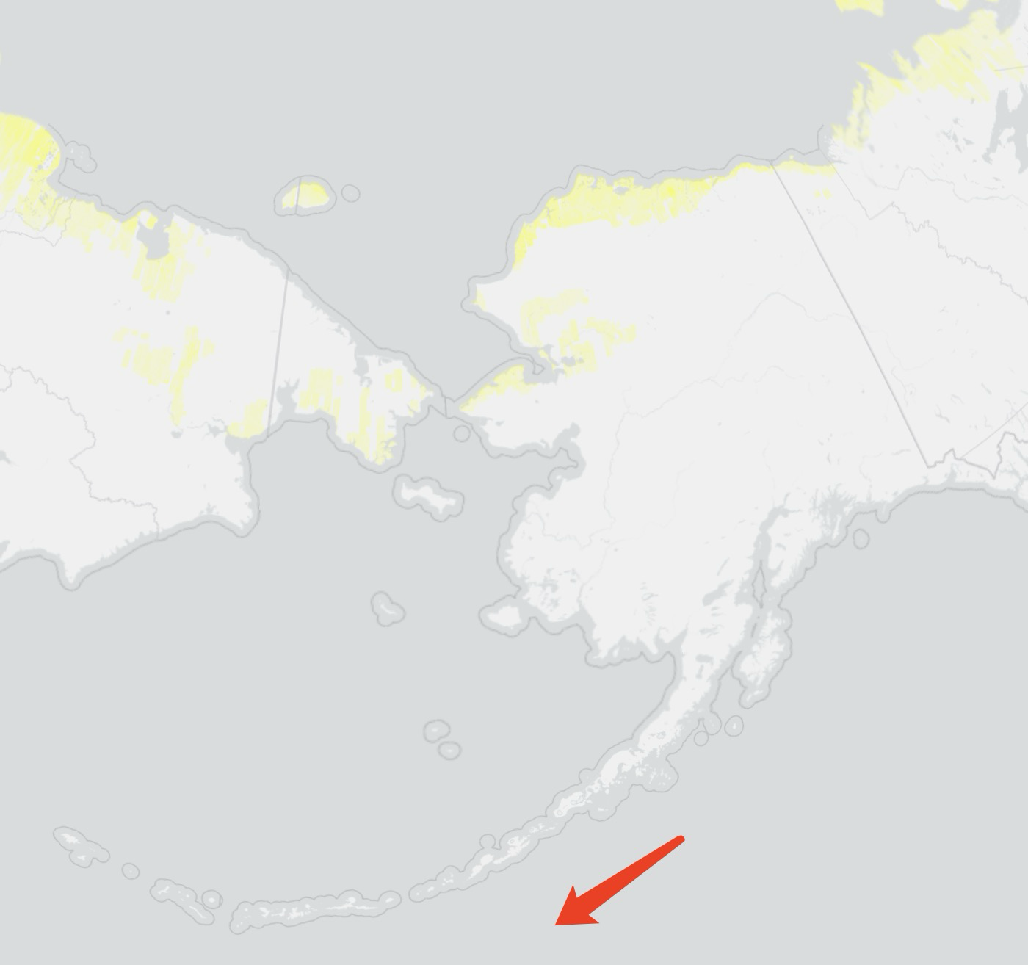
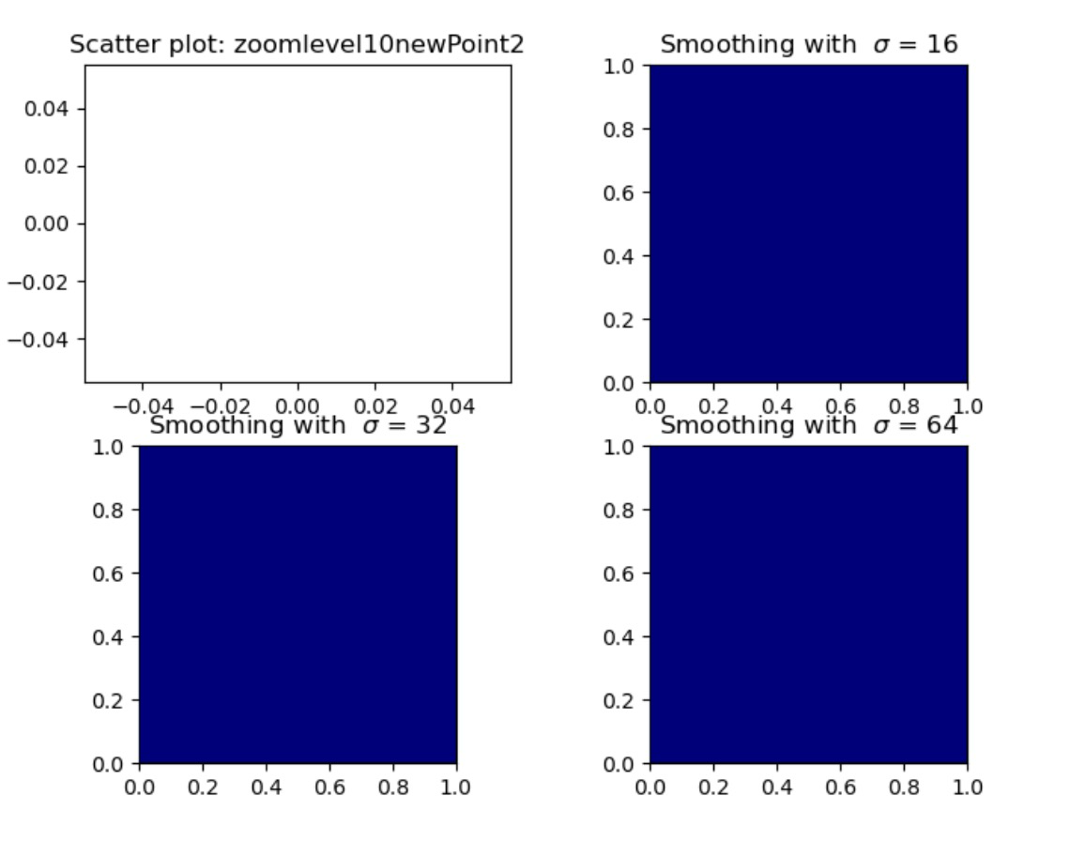
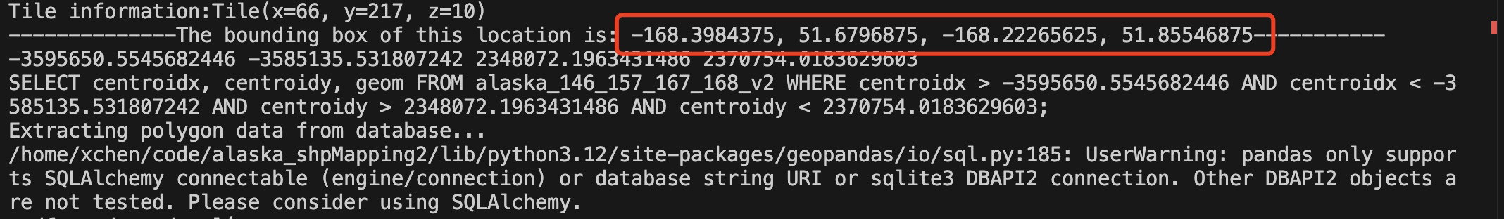
Single Tiles heatmaps
Using mercantile + morecantile

Slide 30
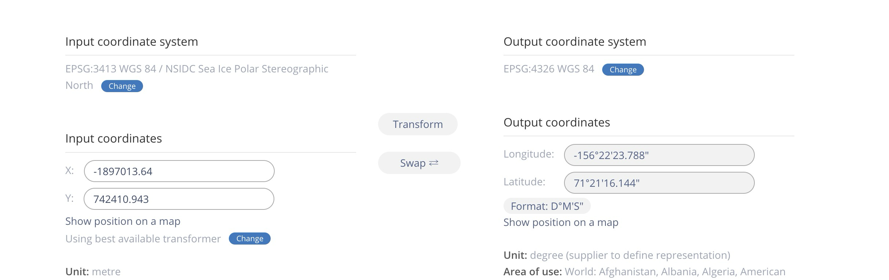
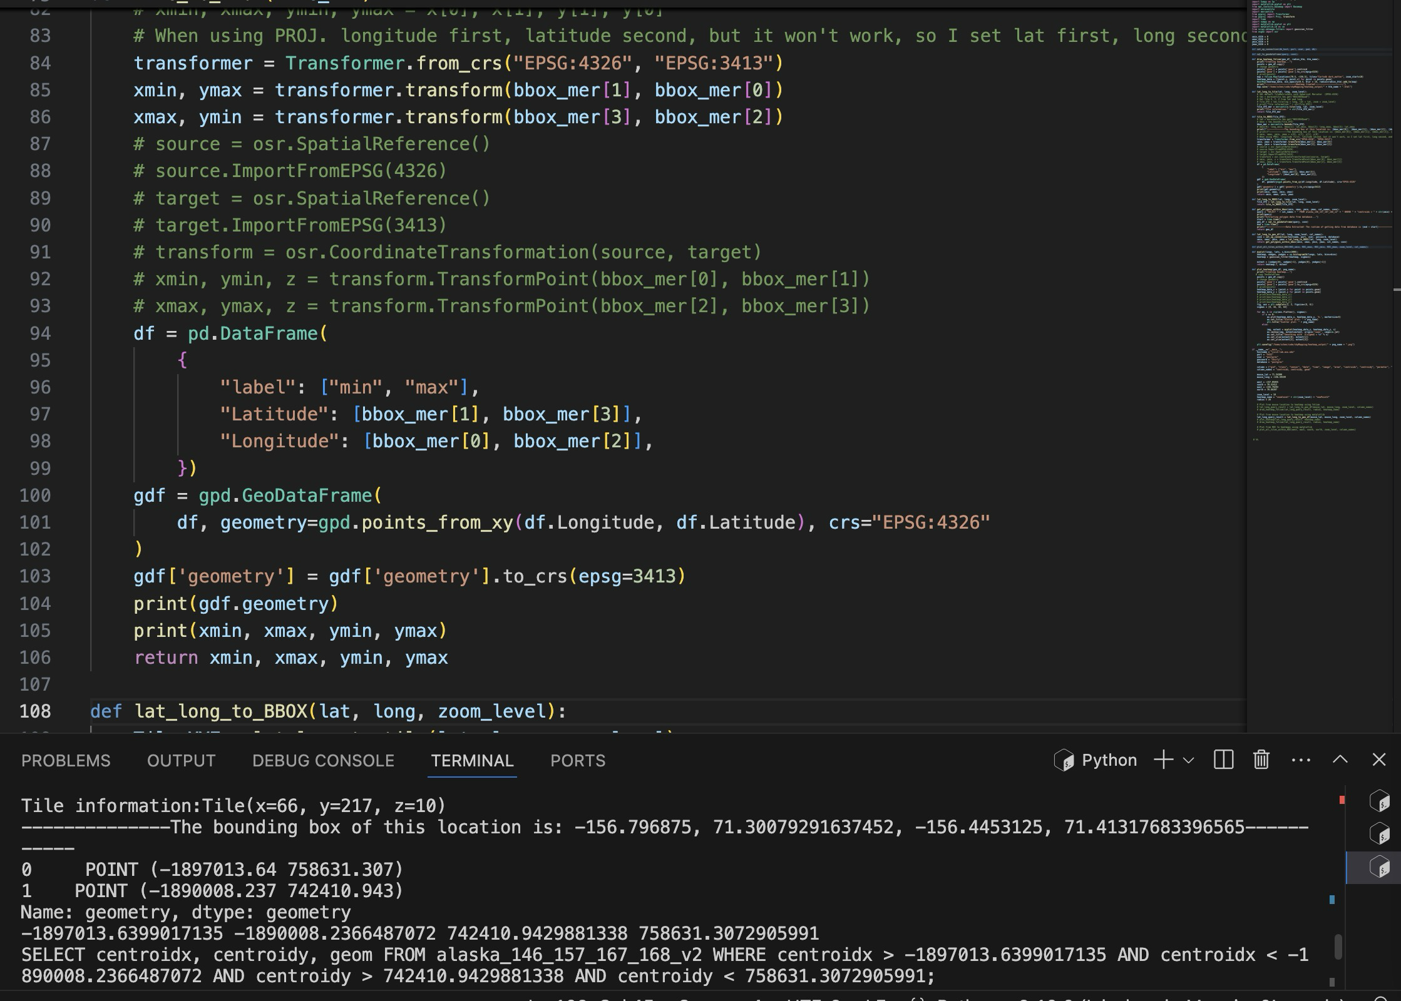
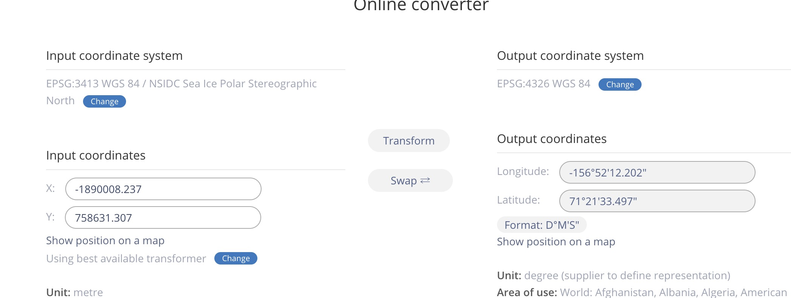
Projection transformation
WTK: Rectangular -> Polygon -> Rectangular

Slide 31
Get all tiles within the ROI
Returns all tiles at this level

Slide 32
Meeting (8/14/2024)
BBOX -> Polygon shape
WKT: Arc
BBOX transformation
①
(xmin, ymax) |  | (xmax, ymax)
(xmin, ymin) |  | (xmin, ymax)
④
②
④
A single tile
①
③
③
②
EPSG: 4326
EPSG: 3413

Slide 33
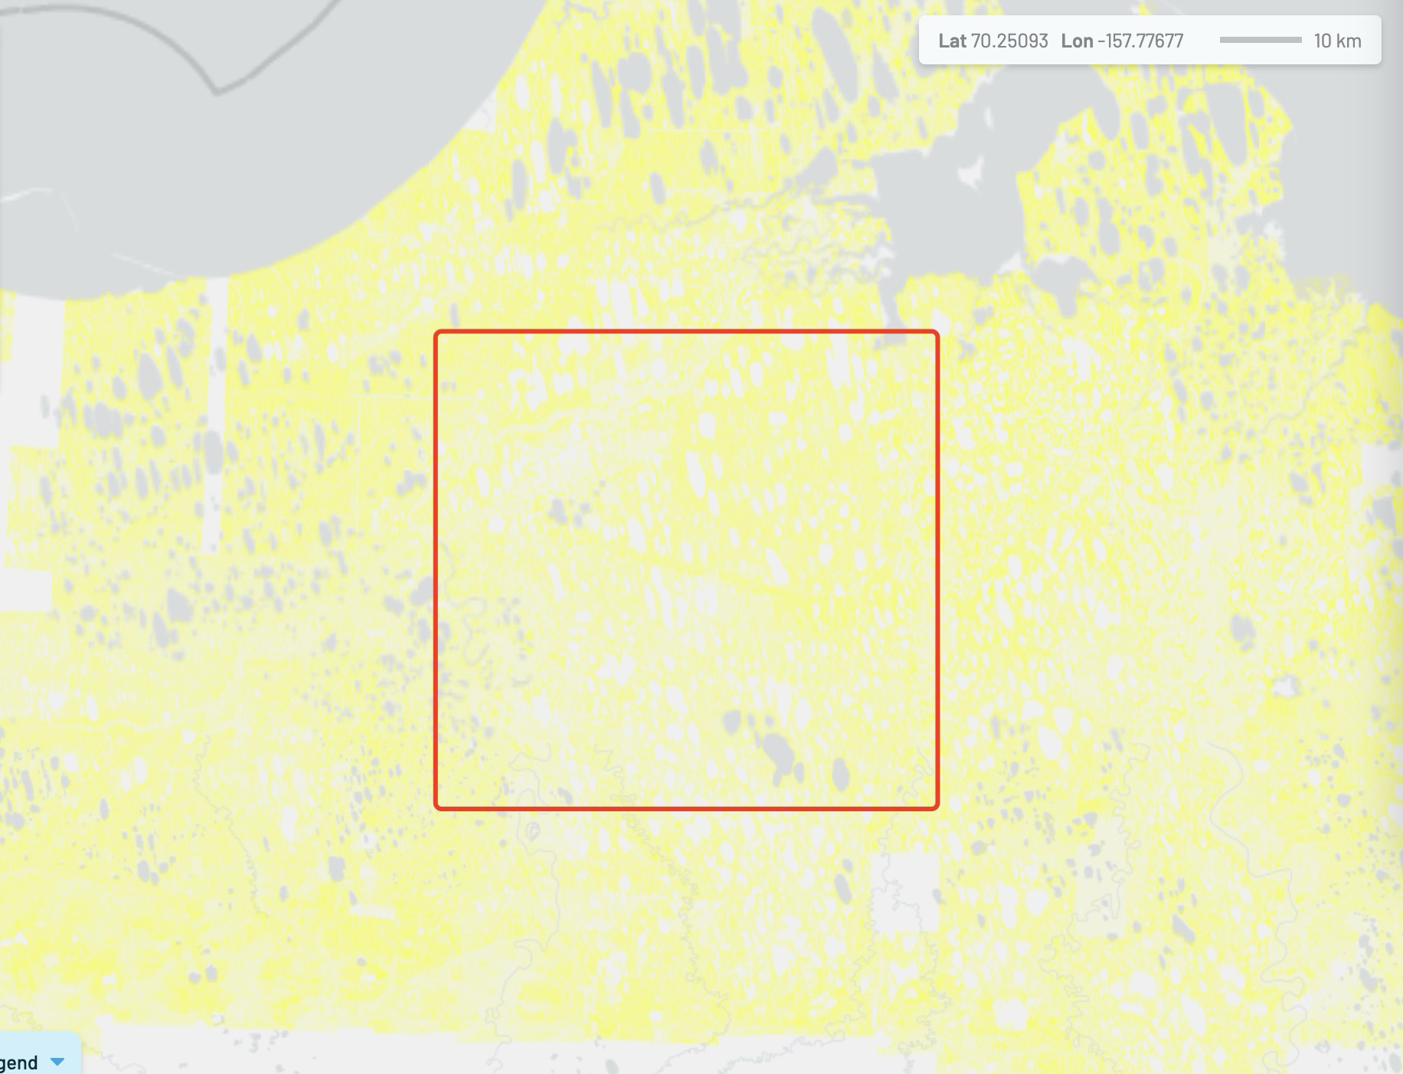
Meeting (8/20/2024)
Import all of the data into database (polygon-based, EPSG: 3413)
Add spatial index
43,000,000
119,124,921 Records in Alaska

Slide 34
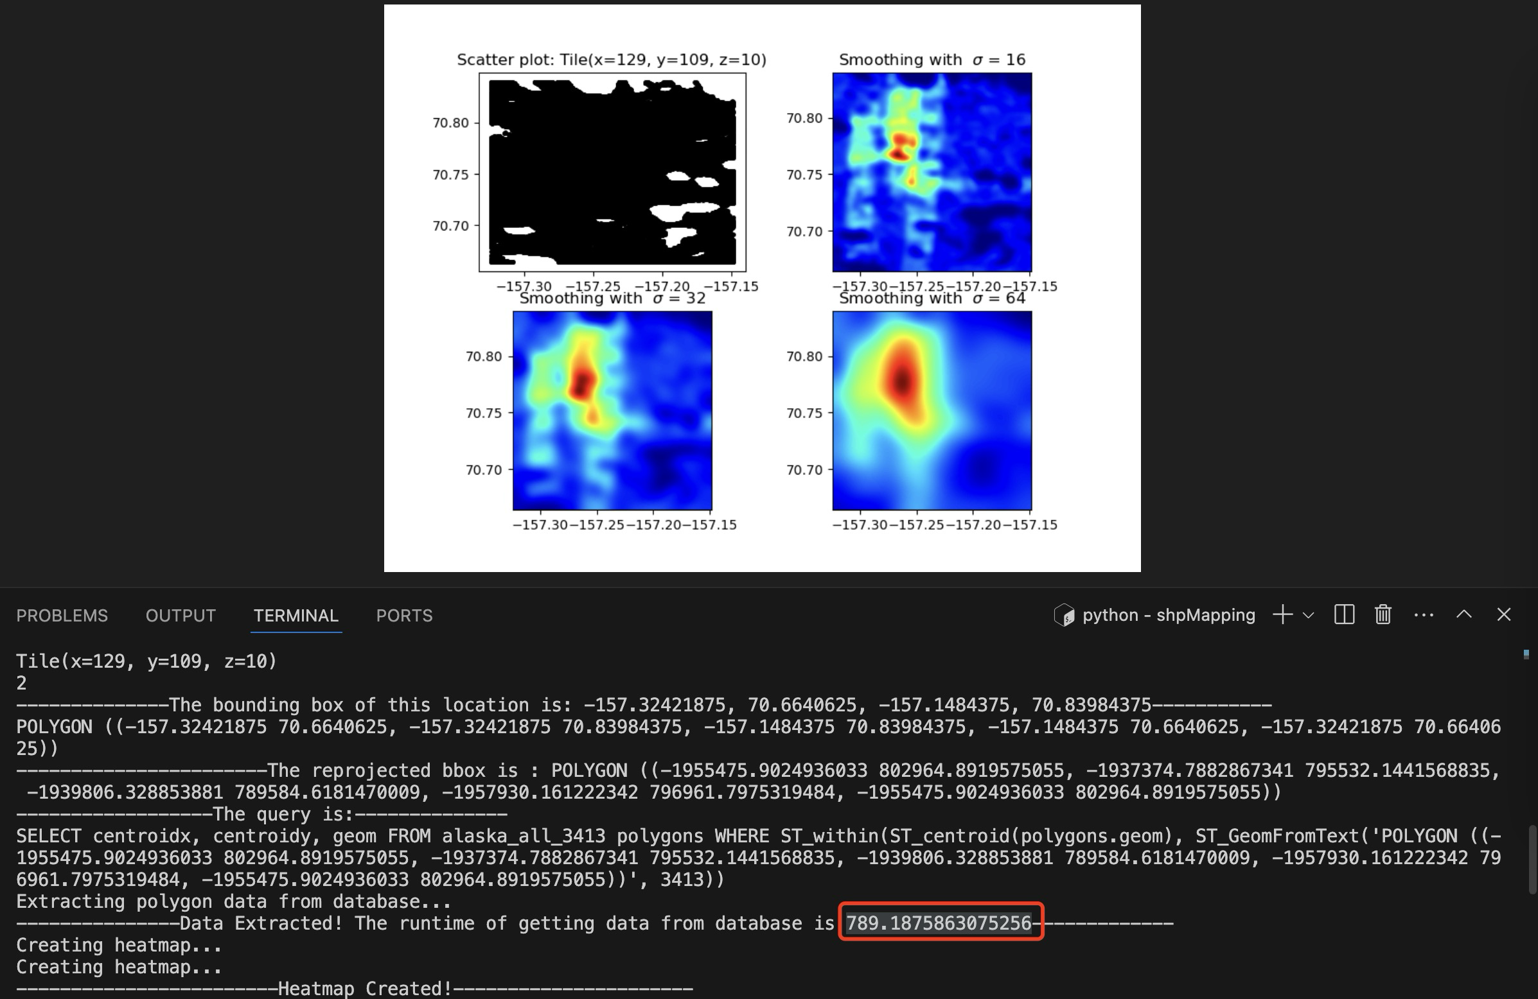
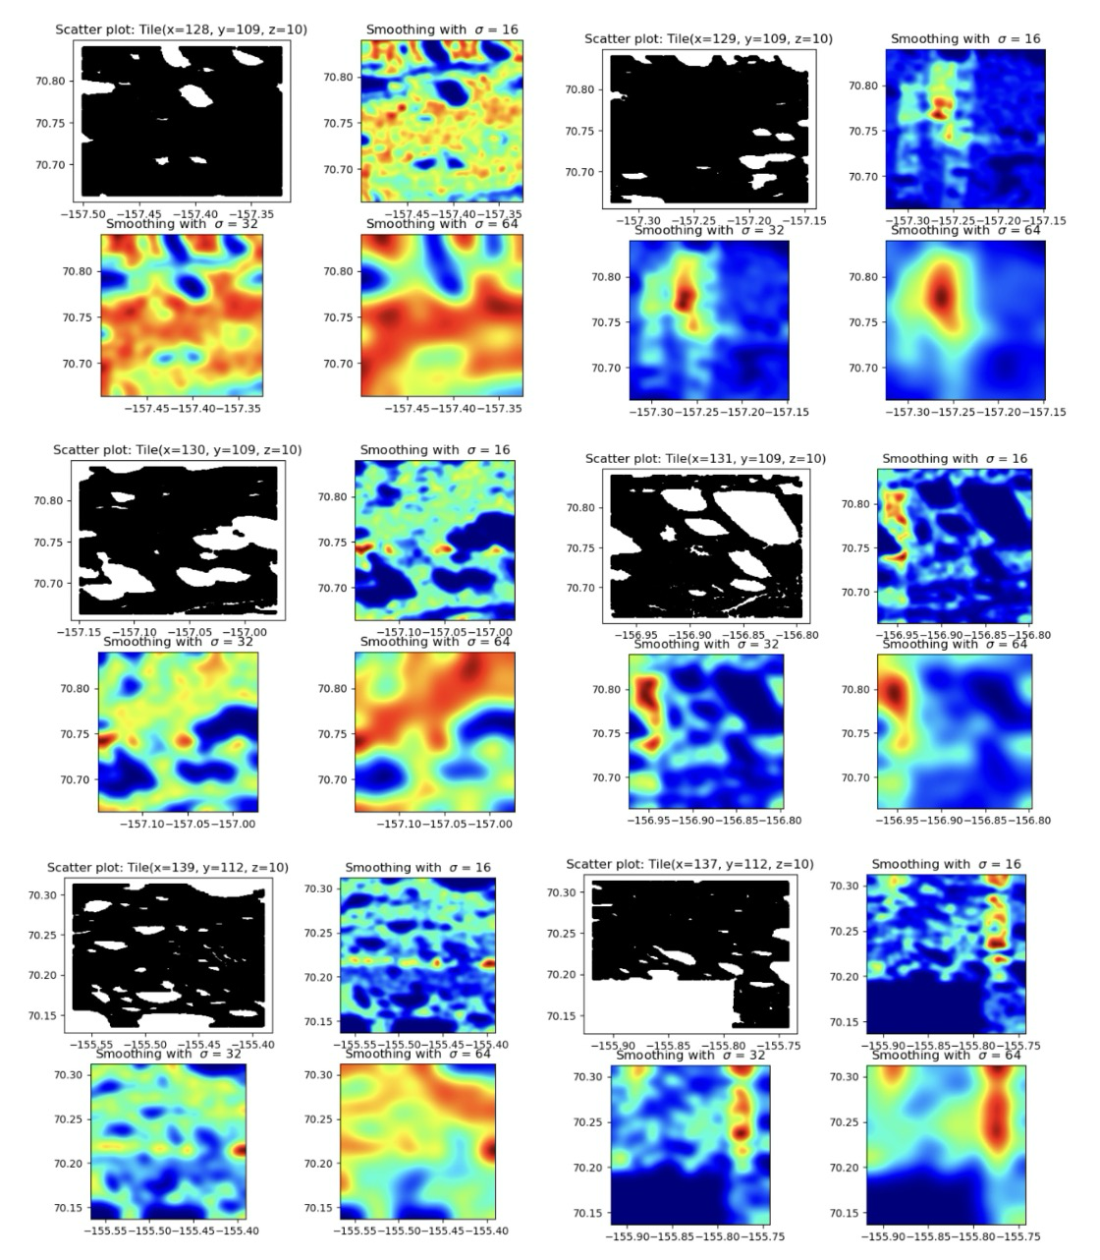

Slide 35
Meeting (8/27/2024)
Spatial index
Heatmap border effect
Color schema ( heatmap value range)
Scalibility

Slide 36
 | Index | vacuum | Database size | Speed
Polygon | No | No | 192GB | ~800s
Polygon | Yes | No |  | ~800s
Polygon + Point | No | Yes | 376GB | ~1200s
Point | No | Yes | 376GB
Point | Yes | Yes | 382GB | 2~12s

Slide 37


Slide 38
With spatial index
Tile(x=128, y=109, z=10)
1
--------------The bounding box of this location is: -157.5, 70.6640625, -157.32421875, 70.83984375-----------
POLYGON ((-157.5 70.6640625, -157.5 70.83984375, -157.32421875 70.83984375, -157.32421875 70.6640625, -157.5 70.6640625))
-----------------------The reprojected bbox is :
POLYGON ((-1953003.2380809318 808960.4285716926, -1934925.0124102354 801472.1823152486, -1937374.7882867341 795532.1441568835, -1955475.9024936033 802964.8919575055, -1953003.2380809318 808960.4285716926))
------------------The query is:--------------
SELECT centroidx, centroidy, geom
FROM alaska_all_3413 polygons
WHERE ST_within(ST_centroid(polygons.geom), ST_GeomFromText('POLYGON ((-1953003.2380809318 808960.4285716926, -1934925.0124102354 801472.1823152486, -1937374.7882867341 795532.1441568835, -1955475.9024936033 802964.8919575055, -1953003.2380809318 808960.4285716926))', 3413))
Extracting polygon data from database...
---------------Data Extracted! The runtime of getting data from database is 830.5624363422394-------------
Creating heatmap...

Slide 39


Slide 40
Without spatial index
Tile(x=128, y=109, z=10)
1
--------------The bounding box of this location is: -157.5, 70.6640625, -157.32421875, 70.83984375-----------
POLYGON ((-157.5 70.6640625, -157.5 70.83984375, -157.32421875 70.83984375, -157.32421875 70.6640625, -157.5 70.6640625))
-----------------------The reprojected bbox is : POLYGON ((-1953003.2380809318 808960.4285716926, -1934925.0124102354 801472.1823152486, -1937374.7882867341 795532.1441568835, -1955475.9024936033 802964.8919575055, -1953003.2380809318 808960.4285716926))
------------------The query is:--------------
SELECT centroidx, centroidy, geom
FROM alaska_all_3413 polygons
WHERE ST_within(ST_centroid(polygons.geom), ST_GeomFromText('POLYGON ((-1953003.2380809318 808960.4285716926, -1934925.0124102354 801472.1823152486, -1937374.7882867341 795532.1441568835, -1955475.9024936033 802964.8919575055, -1953003.2380809318 808960.4285716926))', 3413))
Extracting polygon data from database...
---------------Data Extracted! The runtime of getting data from database is 797.6694705486298-------------
Creating heatmap...

Slide 41
Create a new geom column with centroid points as the geometry
Create the column
SELECT AddGeometryColumn('public', 'alaska_all_3413','geom_centroid',3413,'POINT',2)；
Update the values in the column
update public.Alaska_all_3413 set geom = ST_SetSRID( ST_MakePoint( "Longitude"::double precision, "Latitude"::double precision ), 4326)

Slide 42


Without index

Slide 43

Without Index, but contains polygon and point geometry column

Slide 44
Without Index, delete polygon geometry, but have point geometry column

Slide 45

1
--------------The bounding box of this location is: -157.5, 70.6640625, -157.32421875, 70.83984375-----------
POLYGON ((-157.5 70.6640625, -157.5 70.83984375, -157.32421875 70.83984375, -157.32421875 70.6640625, -157.5 70.6640625))
-----------------------The reprojected bbox is : POLYGON ((-1953003.2380809318 808960.4285716926, -1934925.0124102354 801472.1823152486, -1937374.7882867341 795532.1441568835, -1955475.9024936033 802964.8919575055, -1953003.2380809318 808960.4285716926))
------------------The query is:--------------
SELECT centroidx, centroidy, geom_centroid FROM alaska_all_3413 polygons WHERE ST_within(polygons.geom_centroid, ST_GeomFromText('POLYGON ((-1953003.2380809318 808960.4285716926, -1934925.0124102354 801472.1823152486, -1937374.7882867341 795532.1441568835, -1955475.9024936033 802964.8919575055, -1953003.2380809318 808960.4285716926))', 3413))
Extracting polygon data from database...
/home/xchen/code/alaska_shpMapping2/lib/python3.12/site-packages/geopandas/io/sql.py:185: UserWarning: pandas only supports SQLAlchemy connectable (engine/connection) or database string URI or sqlite3 DBAPI2 connection. Other DBAPI2 objects are not tested. Please consider using SQLAlchemy.
df = pd.read_sql(
---------------Data Extracted! The runtime of getting data from database is 1351.8806235790253-------------

Slide 46

With Index, and point geometry column

Slide 47
Tile(x=128, y=109, z=10)
1
--------------The bounding box of this location is: -157.5, 70.6640625, -157.32421875, 70.83984375-----------
POLYGON ((-157.5 70.6640625, -157.5 70.83984375, -157.32421875 70.83984375, -157.32421875 70.6640625, -157.5 70.6640625))
-----------------------The reprojected bbox is : POLYGON ((-1953003.2380809318 808960.4285716926, -1934925.0124102354 801472.1823152486, -1937374.7882867341 795532.1441568835, -1955475.9024936033 802964.8919575055, -1953003.2380809318 808960.4285716926))
------------------The query is:--------------
SELECT centroidx, centroidy, geom_centroid FROM alaska_all_3413 polygons WHERE ST_within(polygons.geom_centroid, ST_GeomFromText('POLYGON ((-1953003.2380809318 808960.4285716926, -1934925.0124102354 801472.1823152486, -1937374.7882867341 795532.1441568835, -1955475.9024936033 802964.8919575055, -1953003.2380809318 808960.4285716926))', 3413))
Extracting polygon data from database...
/home/xchen/code/alaska_shpMapping2/lib/python3.12/site-packages/geopandas/io/sql.py:185: UserWarning: pandas only supports SQLAlchemy connectable (engine/connection) or database string URI or sqlite3 DBAPI2 connection. Other DBAPI2 objects are not tested. Please consider using SQLAlchemy.
df = pd.read_sql(
---------------Data Extracted! The runtime of getting data from database is 7.471695423126221-------------
Creating heatmap...

Slide 48

Heatmaps for 3 * 3 Tiles, haven’t rescale yet

Slide 49
Meeting 09/03/2024 – 09/10/2024
Rescale the color schema
Extent alignment
Border effect
Applied for each tile in a larger ROI (Scalability)

Slide 50





Rescale the range of color schema, based on global max and min

Slide 51



Extent alignment
Before extent alignment

Slide 52



Extent alignment
Align the data extent returned from database with the tile extent where the heatmap is plotted within

Slide 53

Border effect
“Sigma” is the standard deviation for Guassian kernal, controlling how much the weights in the Gaussian kernel decrease as you move away from the center.
“Radius” is the radius of the Guassian kernal, controlling the actual size of the kernel, i.e., how far from the center the Gaussian function is evaluated.

Slide 54



Border effect
With 𝞂, no radius
𝞂 = 64
𝞂 = 32
𝞂 = 16

Slide 55



Border effect
With 𝞂, no radius
𝞂 = 64
𝞂 = 32
𝞂 = 16

Slide 56



Border effect
Sigma = 64
Radius = 100
Radius = 20
Radius = 5

Slide 57








Border effect
Sigma = 64
Radius = 100
Radius = 20

Slide 58




Border effect
Radius = 10
Sigma = 16
Radius = 100
Radius = 20
Radius = 5

Slide 59

Border effect
𝞂 = 32, radius = 20

Slide 60




Border effect
Radius = 20, no buffer
𝞂 = 32
Radius = 20, no buffer
Radius = 20, buffer = 20
Radius = 20, buffer = 100

Slide 61

Border effect
𝞂 = 32
After clip
Radius = 20, buffer = 100
Radius = 20, buffer = 100

Slide 62


Statistics of the 9 Tiles

Slide 63


Switch to another ROI to test
Tile count: 64
Sigma = 32, radius = 20, buffer = 20

Slide 64
















Switch to another ROI to test
Sample of tiles
Around 37/64 tiles

Slide 65














Scalability
Tile count: 1595
Sigma = 64

Slide 66
Meeting 9/17/2024
Map the count map with 256 * 256 pixels in a tile
Map the coverage ratio map
Pixel: 1km * 1km

Slide 67

Count map

Slide 68


Slide 69
Meeting 9/24/2024
Resize the plot
Change area sum --> coverage percentage
0 values --> Transparent
Check the rotation/flip
Check the data (QGIS/2km*2km)
Check the data via the statistics histogram
Apply to larger scale

Slide 70



Slide 71



Coverage ratio map (before rescale to 0-1)
Coverage ratio map
Polygon:
X: -1981837.4924319359 ~ -1853396.1111618795
Y: 698801.3846376436 ~ 870714.395168513
Extent:
X: 128,441 Y: 171,913

Slide 72

Check the data in 2km resolution
1km resolution
2km resolution

Slide 73



Coverage ratio map (before rescale to 0-1)
Coverage ratio map
Polygon:
X: -2026533.5803334767 ~ -1945685.3317847361
Y: 678120.4396953756 ~ 784280.1615397114
Extent:
X: 80,848 Y:106,160

Slide 74



Coverage ratio map (before rescale to 0-1)
Coverage ratio map

Slide 75




Slide 76






Slide 77
Meeting 10/01/2024
Check the coverage ratio values
Store original area sum at 1*1km resolution → Other resolutions/calculating ratio
Try 2*2km → 10*10km
Then aggregate and store every raster based on this original area sum
Check if the area sum is correct
Delete the buffer of the cell
Check the bounds of the cell
Try on ArcGIS

Slide 78


Check the bounds & IWP counts

Slide 79



Check area sum
ArcGIS

Slide 80

Overlapped area

Slide 81

Overlapped area

Slide 82


Overlapped area

Slide 83


Delete buffer
Ratio map without rescaling
(after deleting buffer)
Ratio map with rescaling
(after deleting buffer)
Ratio map with rescaling
(before deleting buffer)

Slide 84


Delete buffer
Ratio map without rescaling
(after deleting buffer)
Ratio map with rescaling
(after deleting buffer)
Ratio map with rescaling
(before deleting buffer)

Slide 85





Aggregate from 1*1km
1*1km
2*2km
3*3km
5*5km
10*10km

Slide 86
Meeting 10/08/2024
Using geopackages (tile index)
Deduplicate in query per pixel
Dedupilcate from the shapefile

